Slide 1






NON
TOWNHALL
PROFIT
Friday, August 22, 2025
10 AM - 12 PM

Slide 2

Thank you to our host!

Slide 3
Thank you to our partners!

Slide 4
Agenda
10:15 AM
10:30 AM
10:40 AM
11:00 AM
11:20 AM
11:50 AM
Welcome
Nonprofits of the Year
Legislative & Budget Updates
State of the Nonprofit Sector
Q&A and Dialogue
Closing

Slide 5


A Message from
Senator Monique Limón
Nonprofit Town Hall - Sen. Limón Remarks

Slide 6
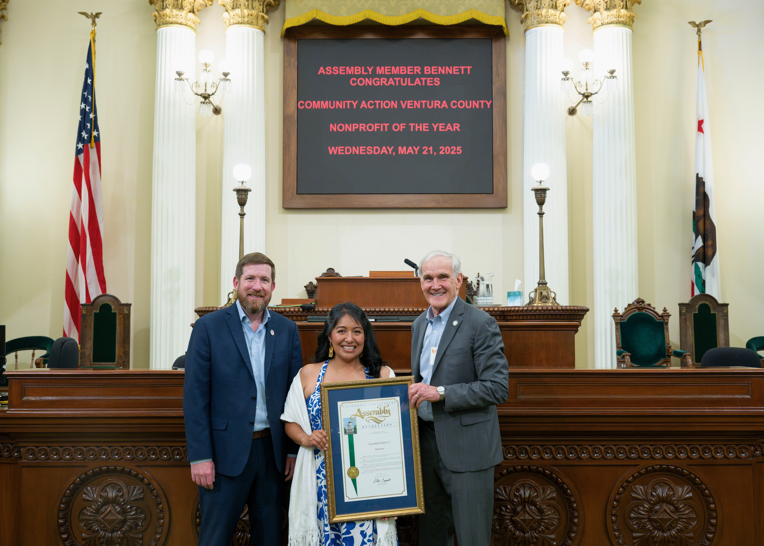

38th Assembly District's
2025 Nonprofit of the Year
Community Action of Ventura County
Nonprofit’s webpage

Slide 7
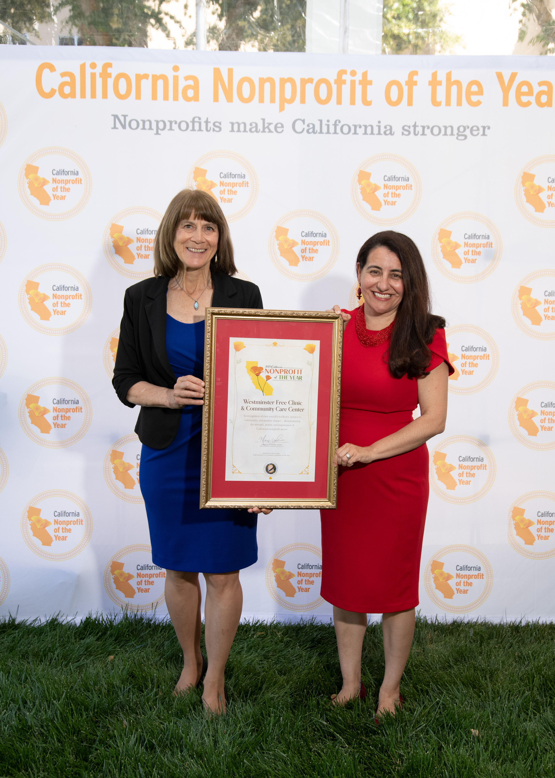

21st Senate District's
2025 Nonprofit of the Year
Westminster Free Clinic
Nonprofit’s webpage

Slide 8
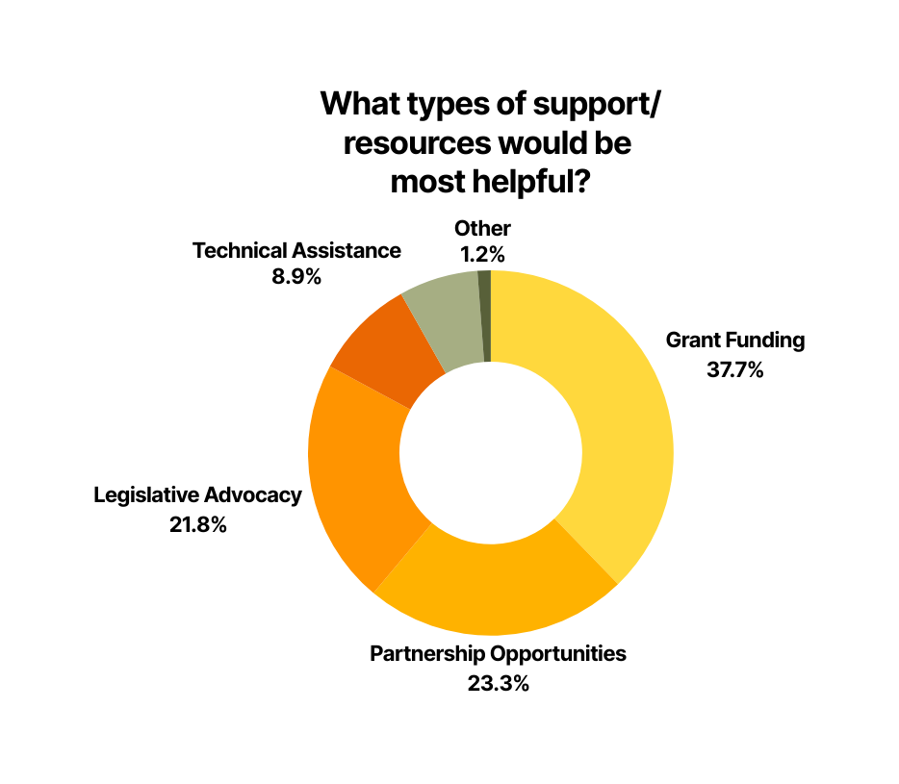
Survey Responses

Slide 9

Update from
Assemblymember Gregg Hart

Slide 10
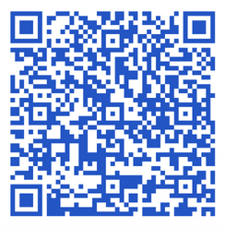
AB 880 (Bennett): Prompt Payments
for Nonprofits
California State Nonprofit Security Grant Program.
  Ensures prompt payment and fair compensation for services.
  Expands Prompt Payment Act to include nonprofit grants.
  Aligns indirect cost rates with federal standards.
  Helps nonprofits cover essential operating expenses.
  Ensures fair pay for direct & indirect costs, especially for groups serving vulnerable communities.
Legislation webpage

Slide 11

State Budget FY25-26 Overview
  Initial projection: modest economic growth & slight surplus
  Early-year revenues exceeded expectations
  Federal policy changes significantly slowed growth in the California economy
  California also experienced substantial cost and caseload growth in several core state programs - most notably in Medi-Cal
  Spends $228B from the state’s General Fund
  $11.8B General Fund shortfall
eBudget site

Slide 12
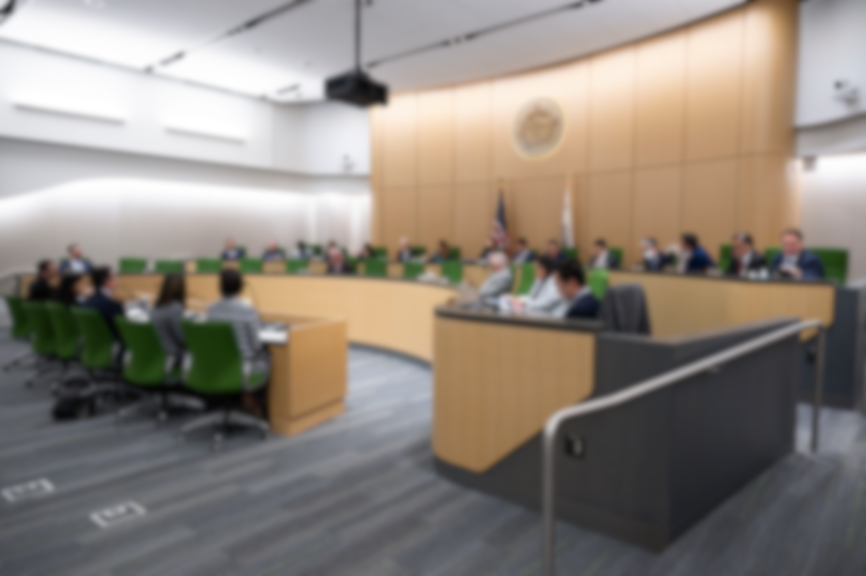
Solutions
Internal Borrowing
$7.8 billion
55%
Fund shifts
$1.2 billion
21%
Spending reductions
$2.8 billion
24%
Rainy Day fund
pulled $7.1 B

Slide 13



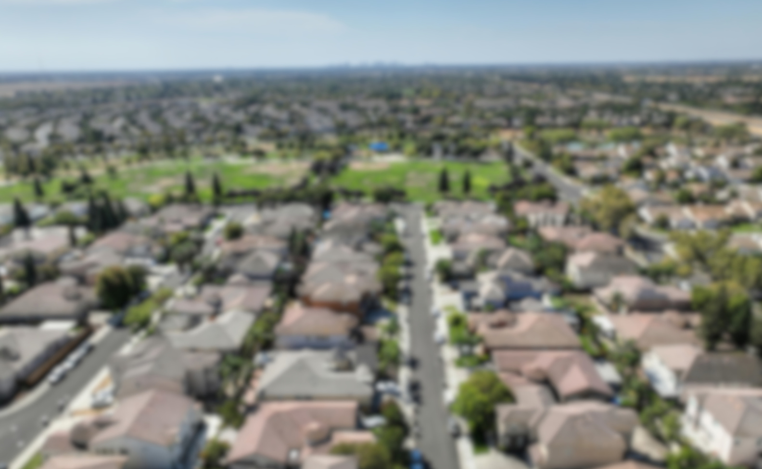

Highlightss
Protects Prop 98
K-12 & community college funding
$1.7B
Student support & mental health services
$300M
Teacher workforce investments
$500M
Low-Income Housing Tax Credit
$100M
Encampment Resolution Grants

Slide 14




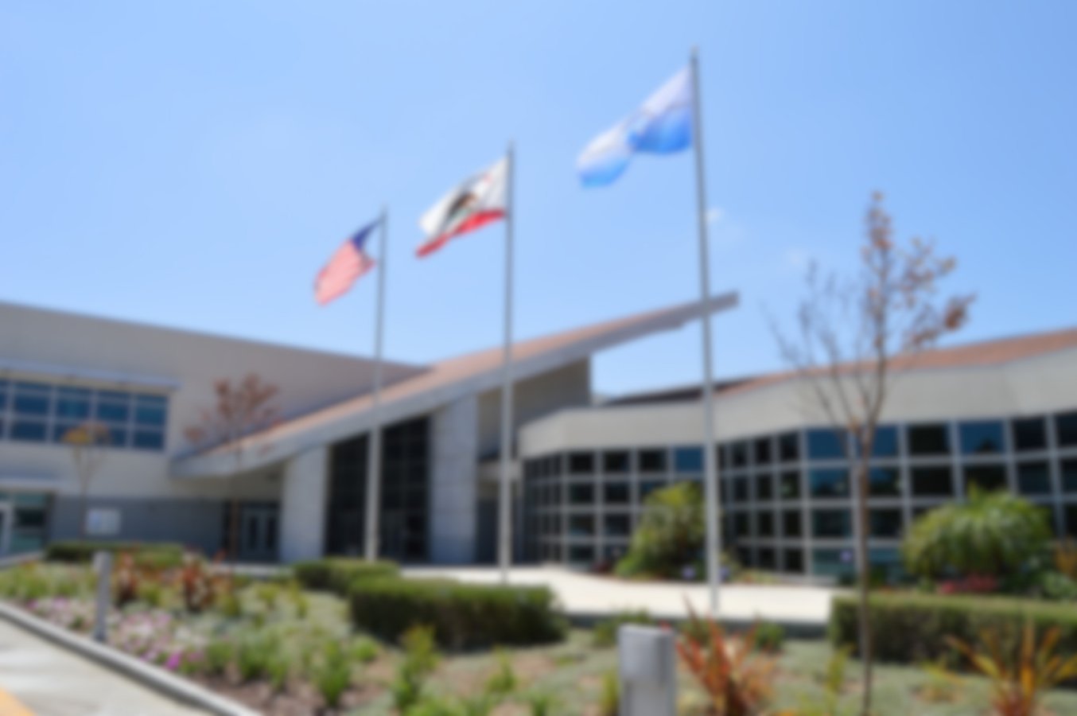
Other Key Priorities
$2.1 B
Universal Transitional Kindergarten
564
CAL FIRE positions
$378.6M
Expanded Learning Opportunities
$145M
Universal
School Meals
$378.6M
Learning Recovery Grants

Slide 15
Reductions
$2.8B in total solutions in 2025-26, growing to $11.9B by 2028-29
Significant impacts to Healthcare:
  Medi-Cal: freezes new enrollment for undocumented adults ages 19 and older starting in 2026
  Asset limits reinstated
  $30 premium for certain immigrant populations (2027)
  Elimination of Dental Benefits, Adults 19 and Older for certain immigrant populations

Slide 16

State of the Nonprofit Sector
from Geoff Green, CEO

Slide 17
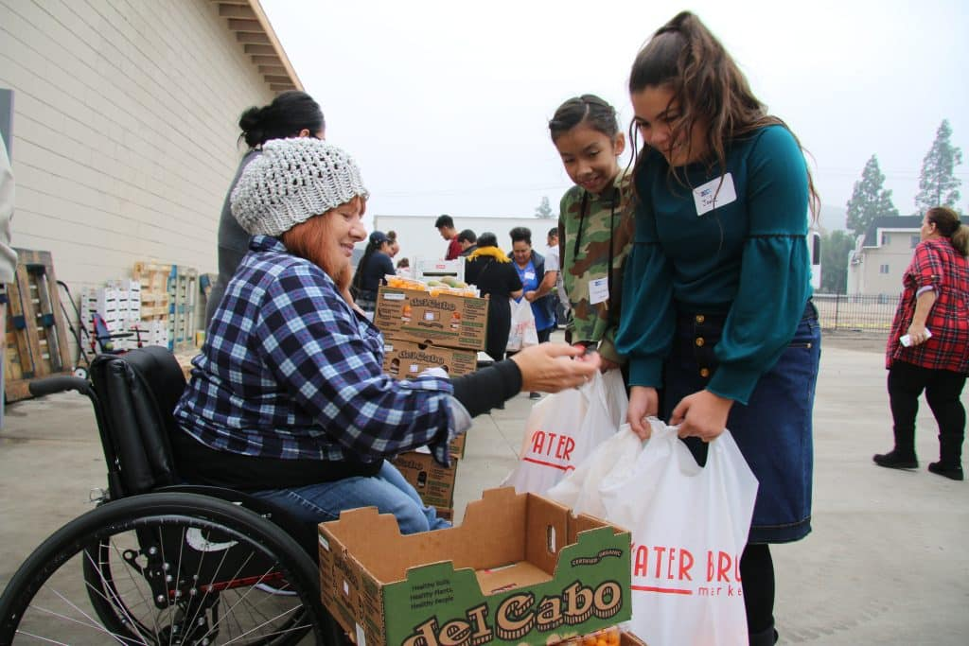



Nonprofit Town Hall
~ August 22, 2025 ~

Slide 18




As the leading policy voice for California’s nonprofit sector, CalNonprofits focuses on advocacy, education, and research to build a more powerful and politically engaged nonprofit network across the state
Policy & Advocacy
Education
Data & Research

Slide 19
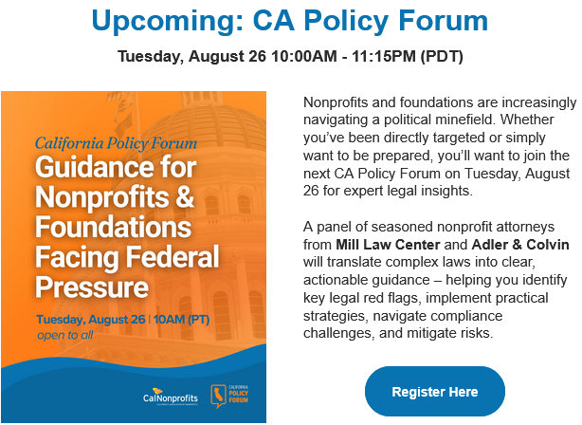
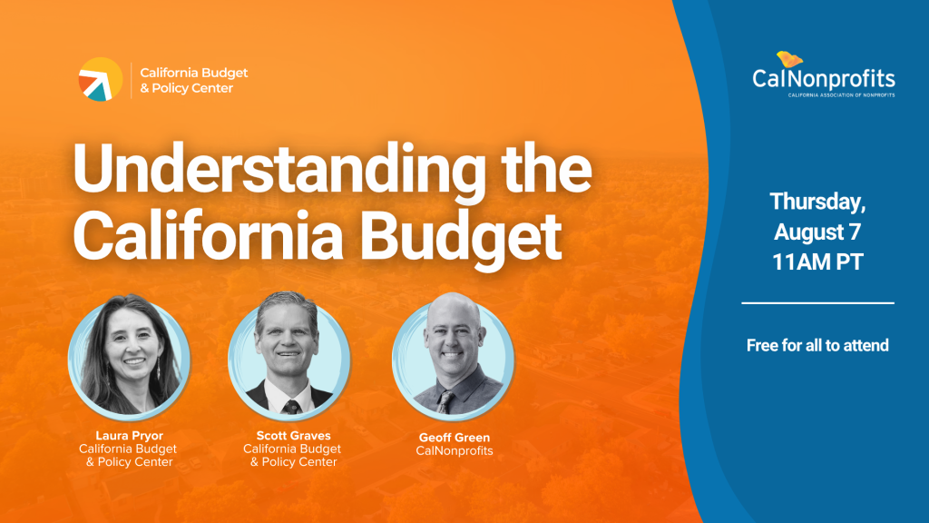
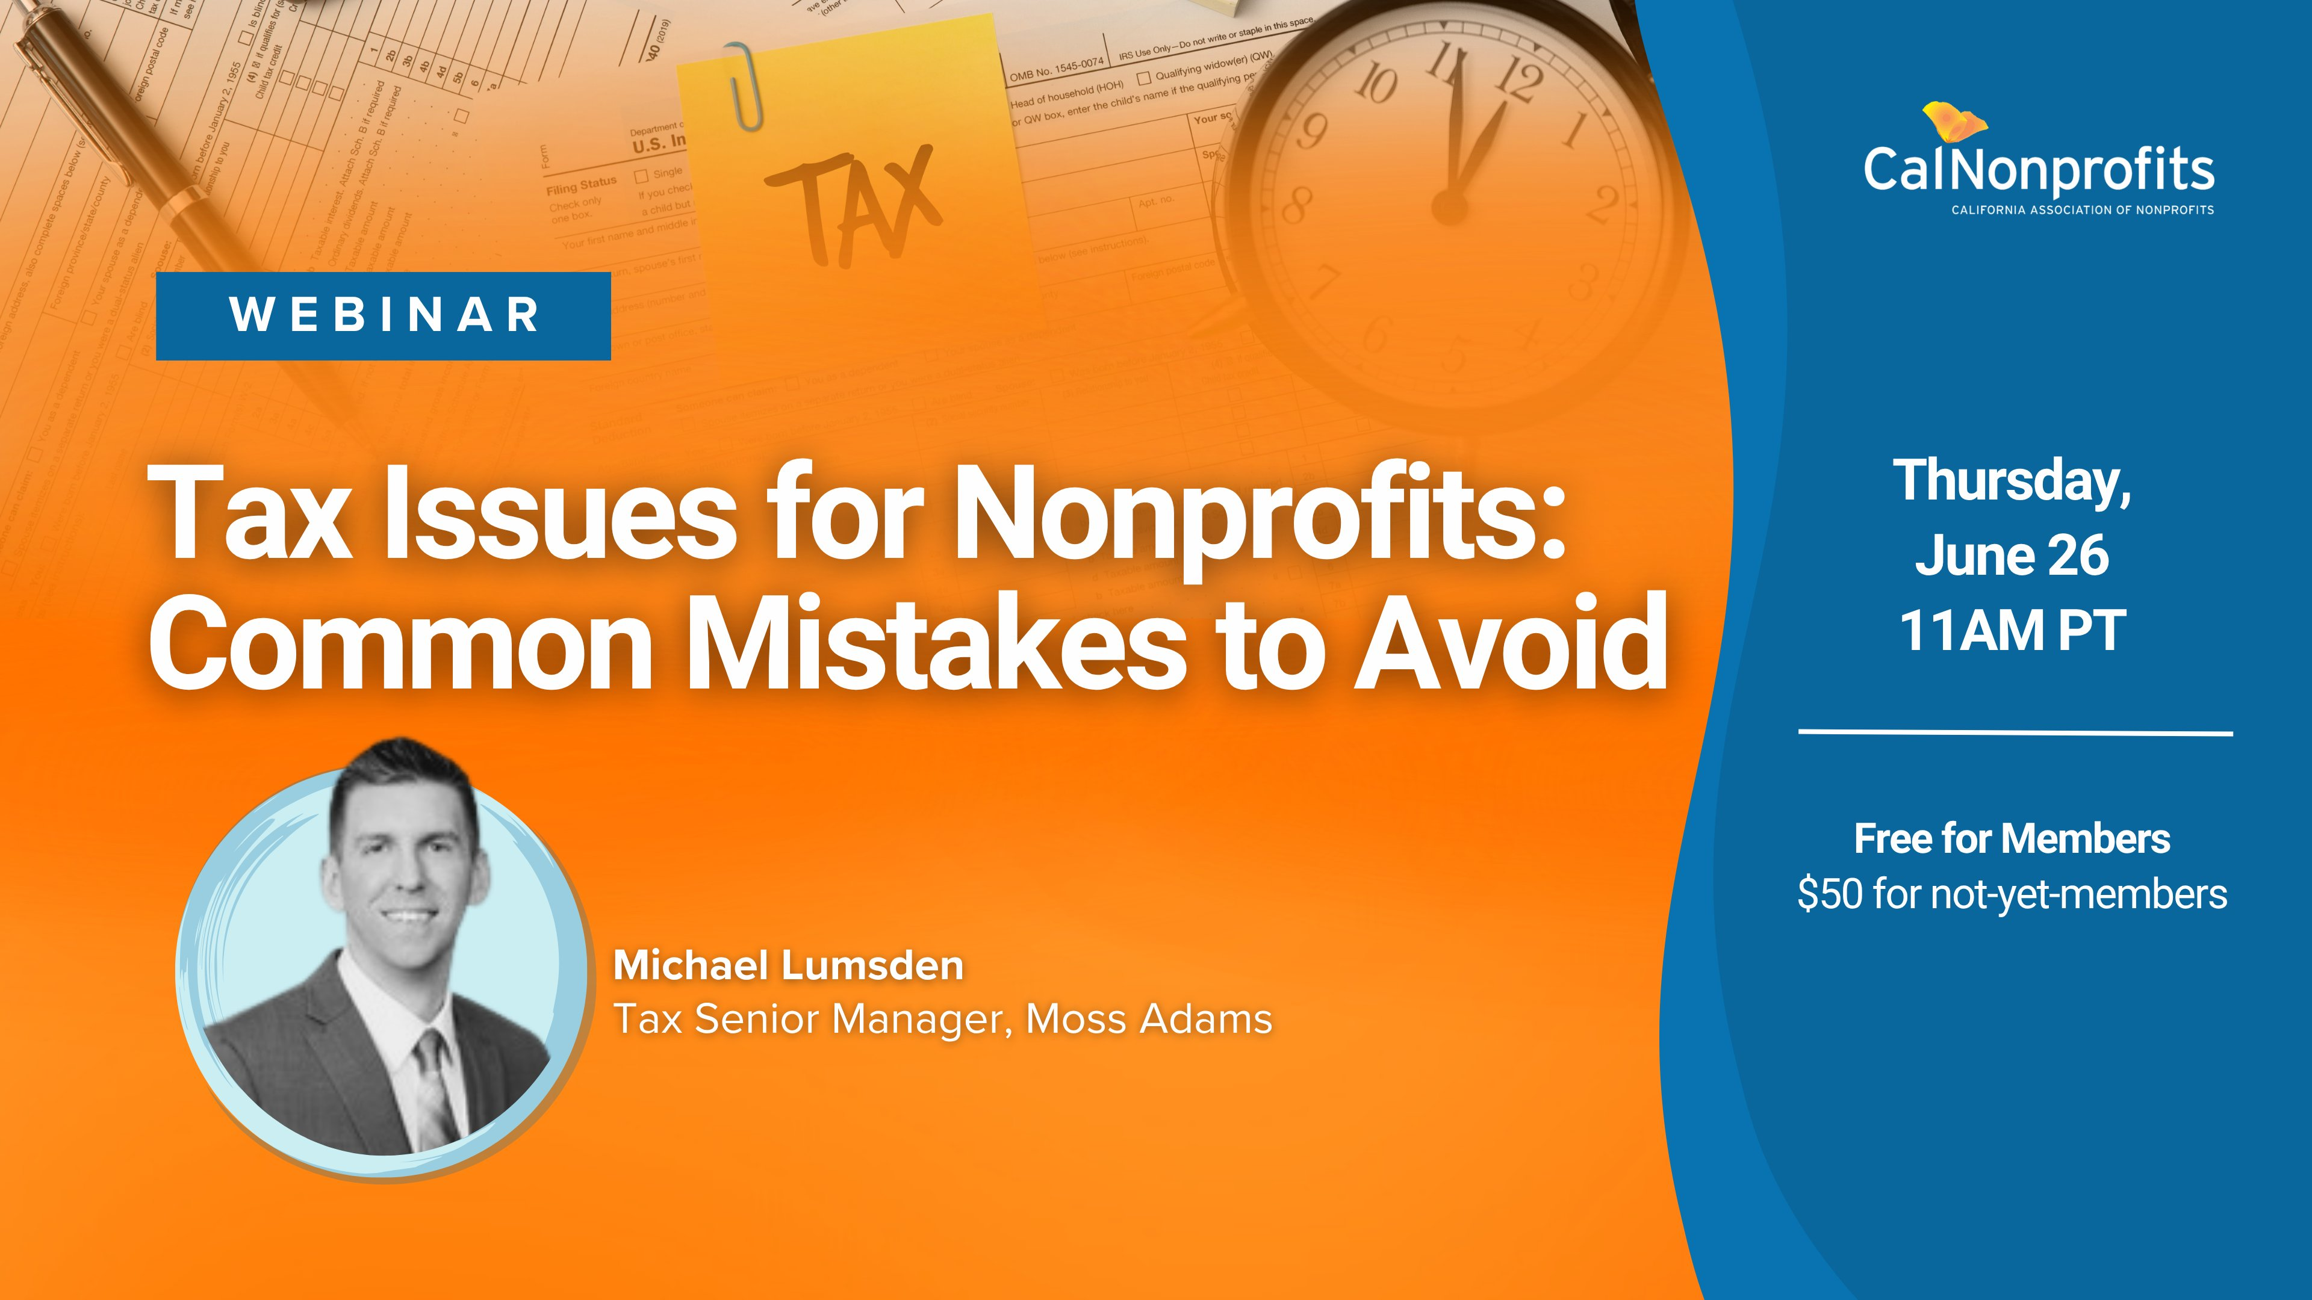

Education
77% fill a gap left
www.calnonprofits.org

Slide 20
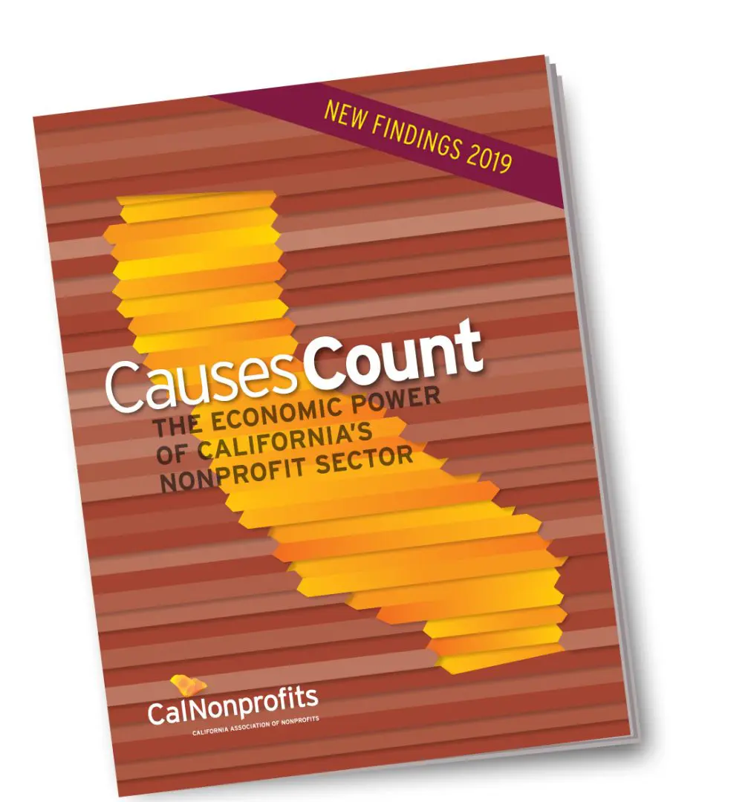
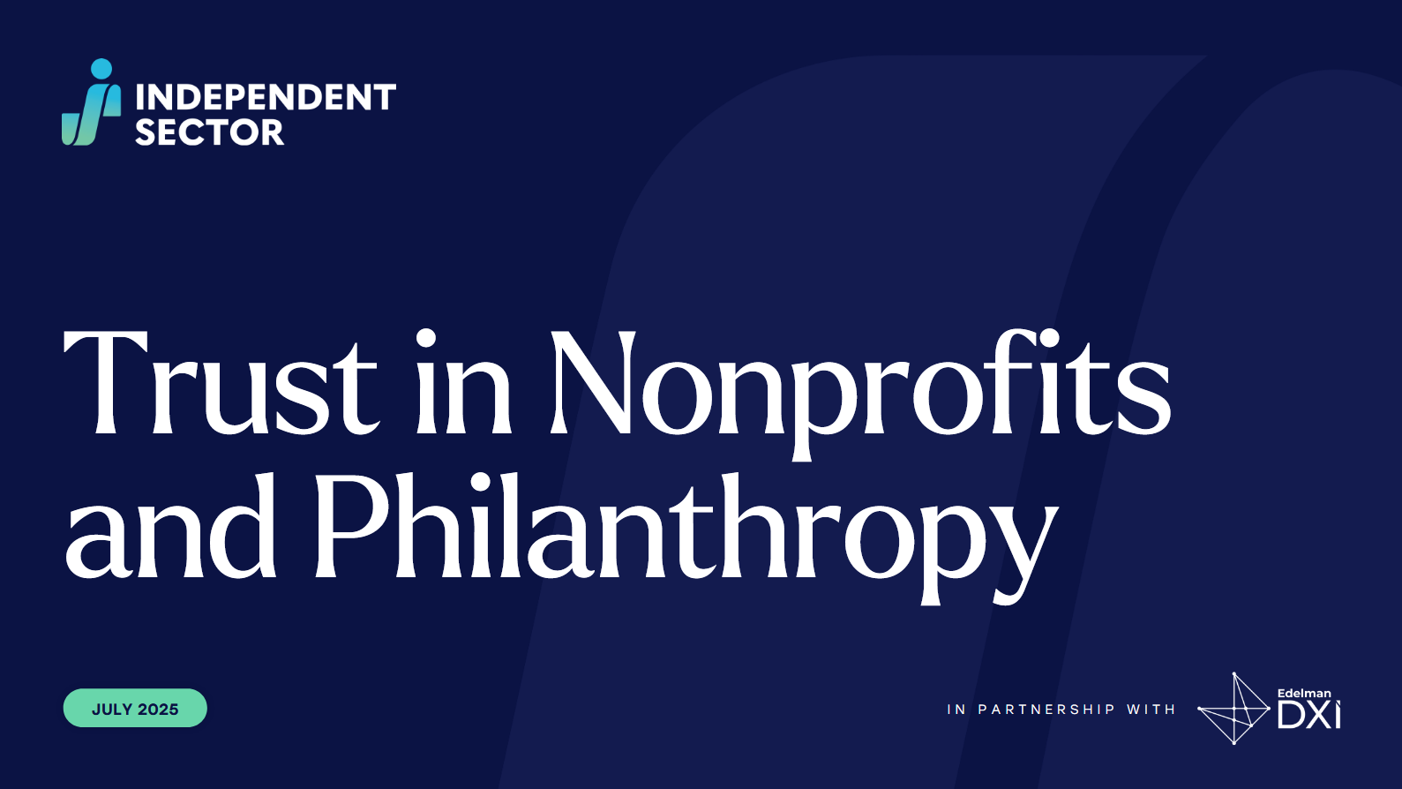



Data & Research
77% fill a gap left
www.calnonprofits.org

Slide 21
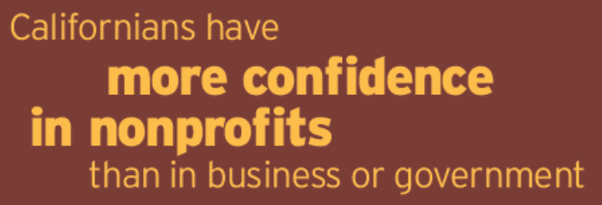
90% Help the needy and vulnerable
46% Help people like me
19% Help people who don’t deserve help
85% Improve quality of life
78% Stand for values
60% Reduce inequality
77% fill a gap left
77% Fill a gap left by government
72% Fill a gap left by private business and corporations
Source: California Resident Survey (2018-2019)
www.calnonprofits.org

Slide 22
What’s the latest?
Federal Policy Update

Slide 23
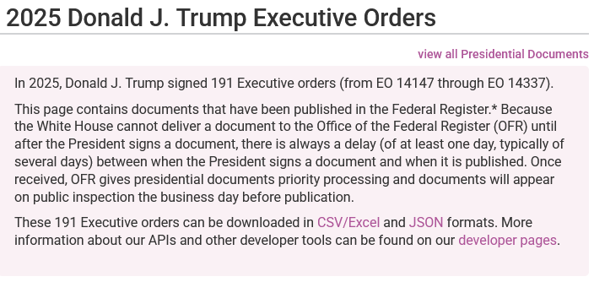
191 Executive Orders (as of Aug 20, 2025)
https://www.federalregister.gov/presidential-documents/executive-orders/donald-trump/2025
www.calnonprofits.org

Slide 24

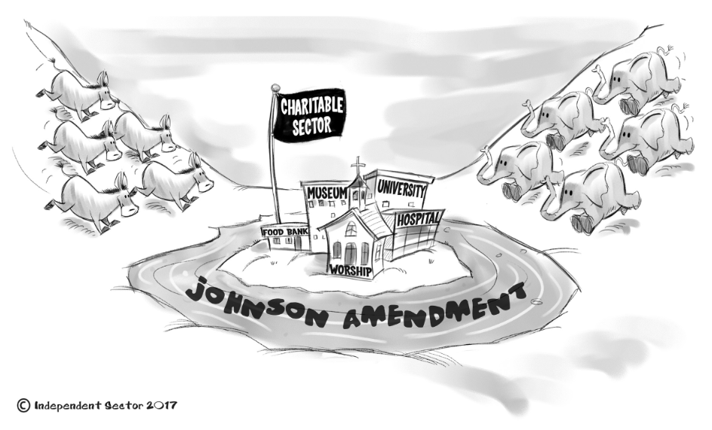
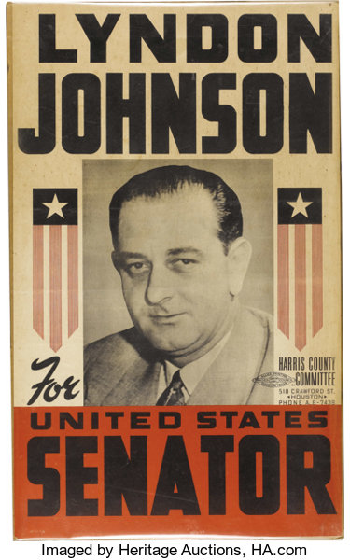
The Johnson Amendment (since 1954)
www.calnonprofits.org

Slide 25
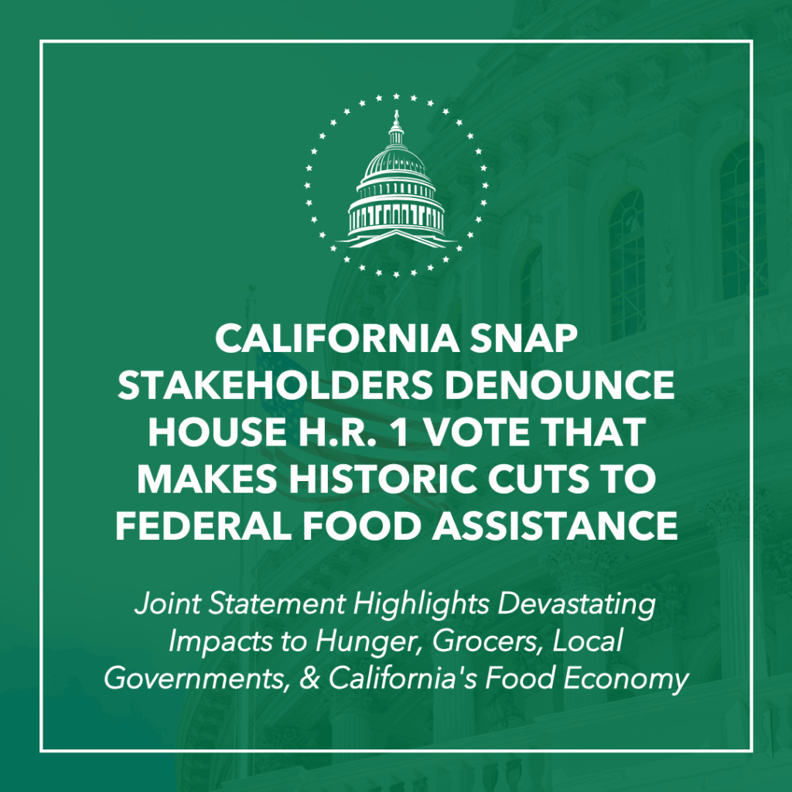
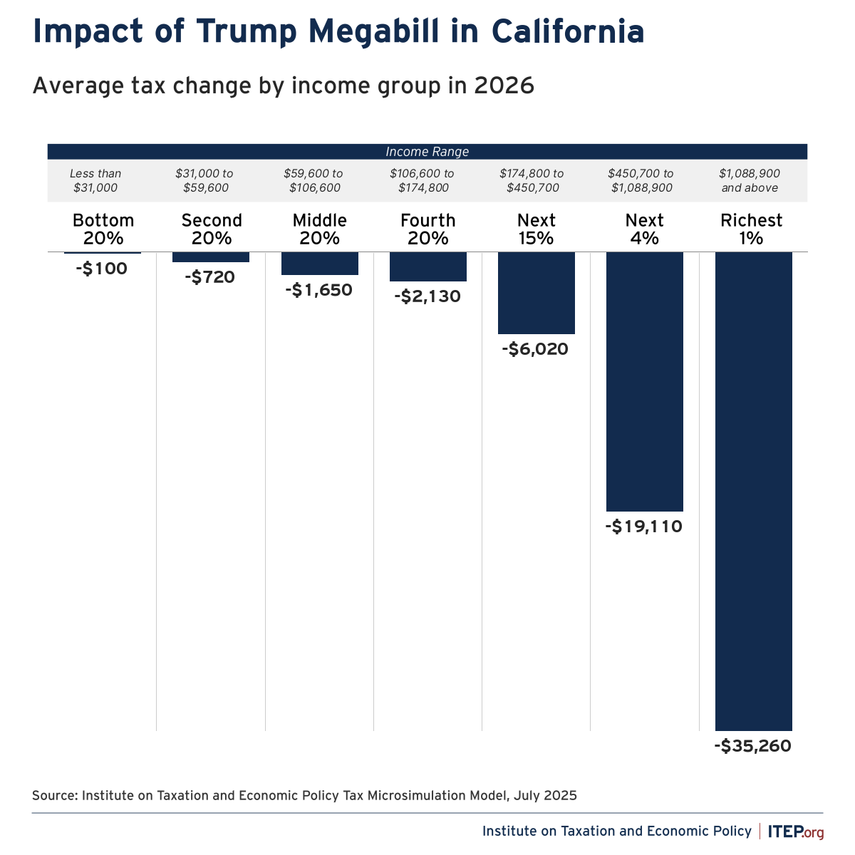
H.R. 1
www.calnonprofits.org

Slide 26

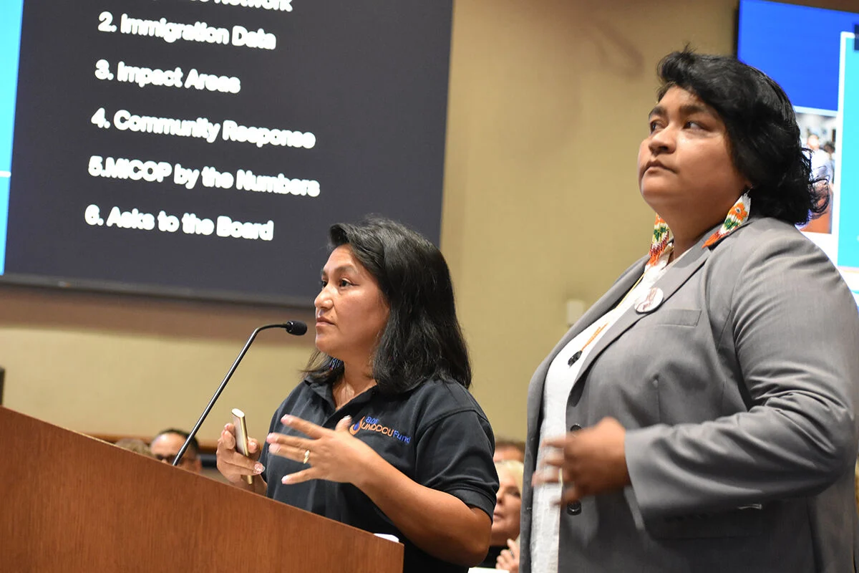


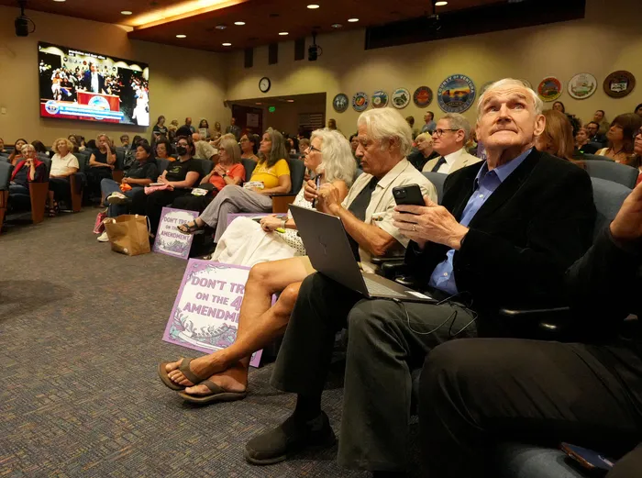
Federal Immigration Raids & Local Response
www.calnonprofits.org

Slide 27
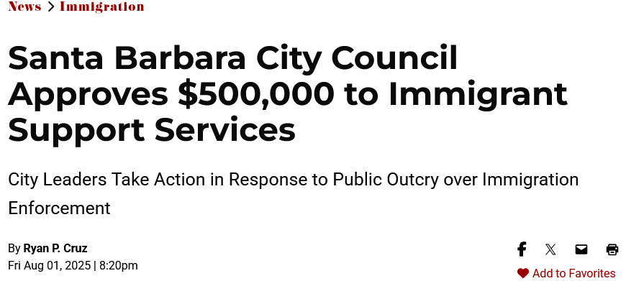
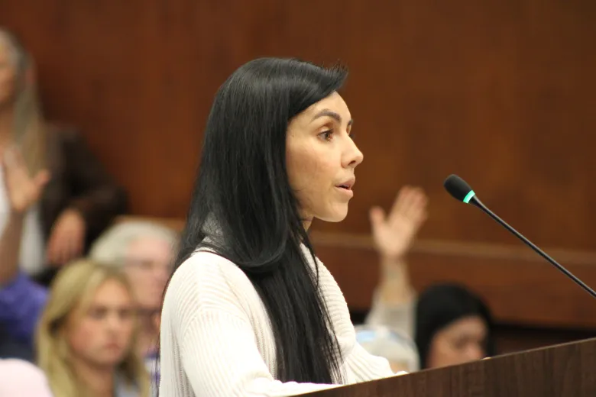
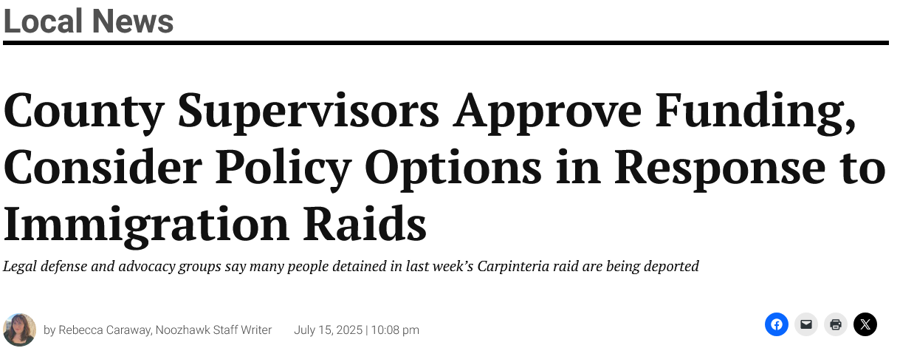


Federal Immigration Raids & Local Response
www.calnonprofits.org

Slide 28






Resources for Tracking Impacts…
www.calnonprofits.org

Slide 29
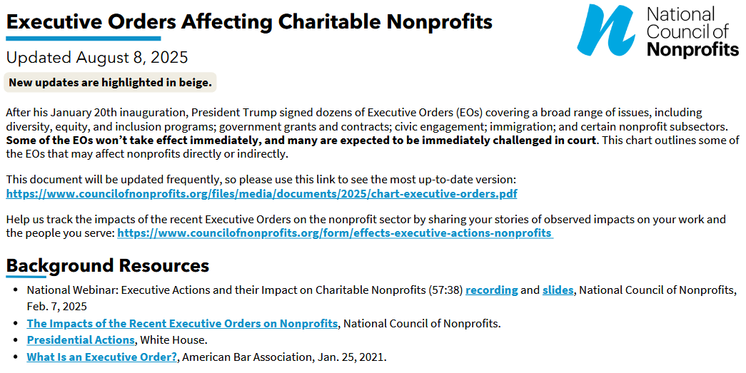
Executive Orders and What They All Mean…
https://www.councilofnonprofits.org/files/media/documents/2025/chart-executive-orders.pdf
www.calnonprofits.org

Slide 30
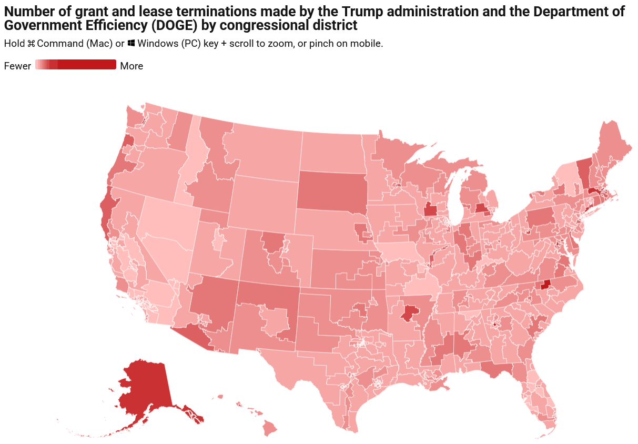
https://www.americanprogress.org/article/doge-cuts-by-city-state-and-congressional-district/

Slide 31
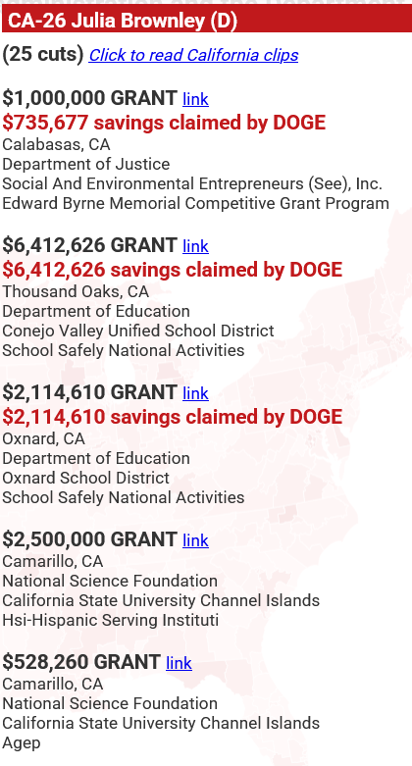
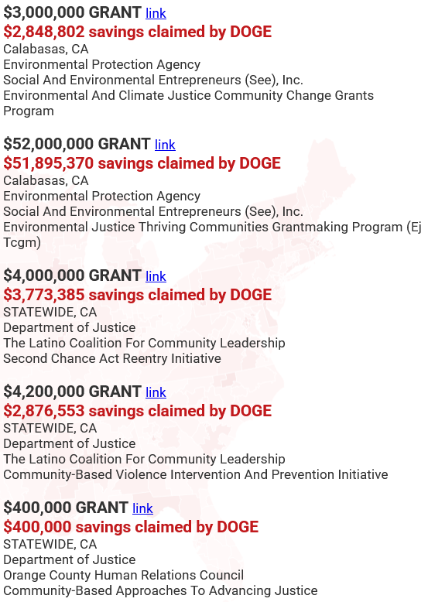
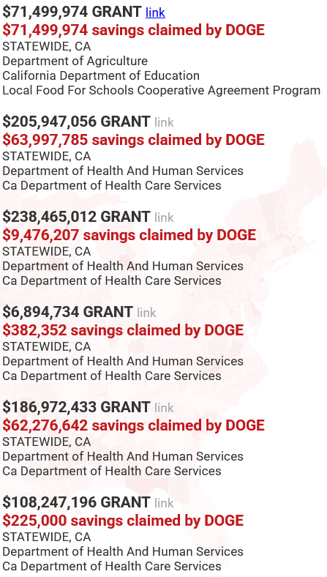
https://www.americanprogress.org/article/doge-cuts-by-city-state-and-congressional-district/
www.calnonprofits.org

Slide 32
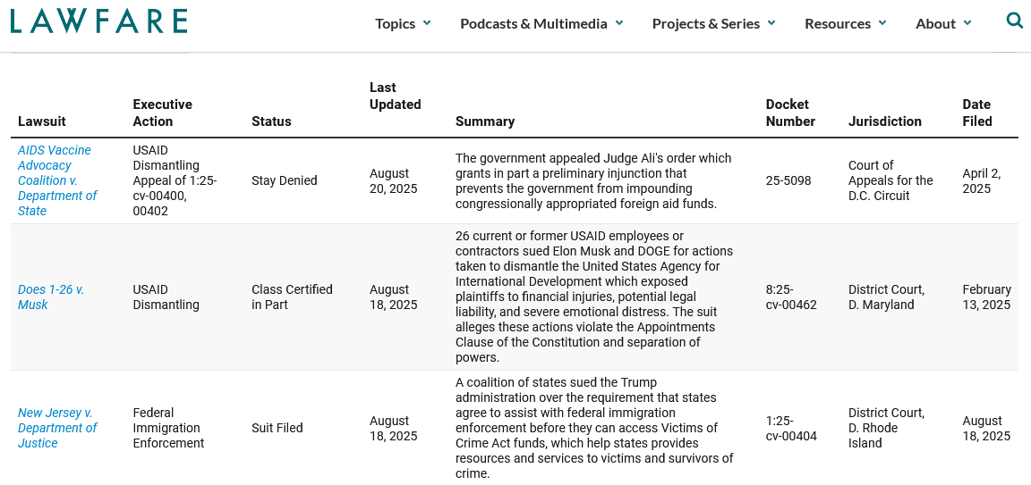
https://www.lawfaremedia.org/projects-series/trials-of-the-trump-administration/tracking-trump-administration-litigation
https://www.lawfaremedia.org/projects-series/trials-of-the-trump-administration/tracking-trump-administration-litigation
www.calnonprofits.org

Slide 33

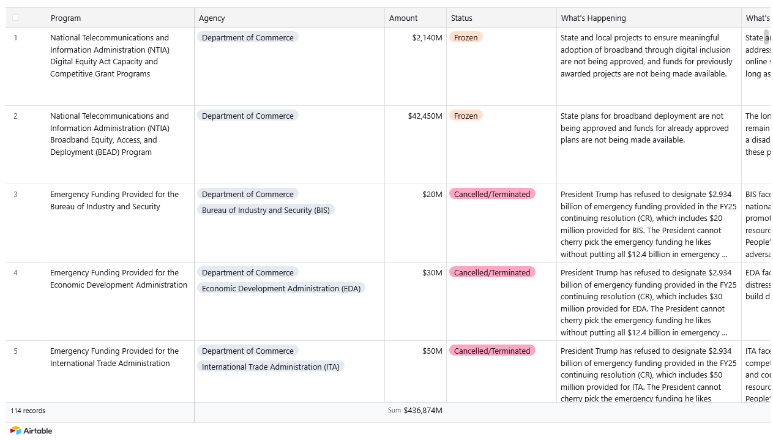
$436,874,000
https://www.appropriations.senate.gov/trumps-funding-freeze
www.calnonprofits.org

Slide 34
What’s up in California?
Meanwhile, Back Home…

Slide 35
$436,874,000
https://www.appropriations.senate.gov/trumps-funding-freeze
www.calnonprofits.org

Slide 36
What’s up in California?
Meanwhile, Back Home…

Slide 37
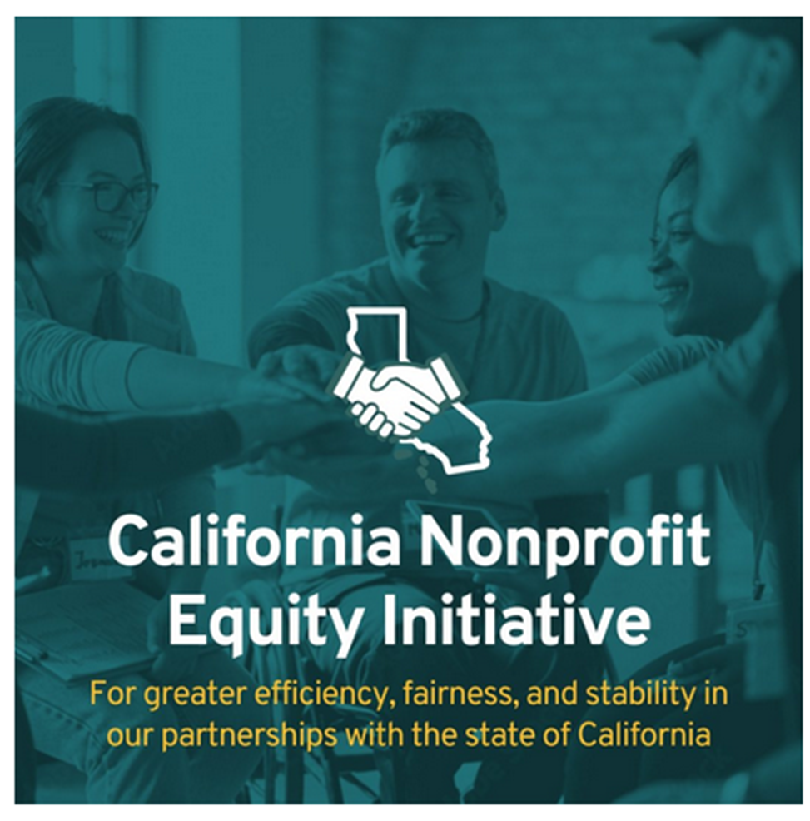
CalNonprofits’ Policy Priorities
Advocate for public investment in our communities
Improve and strengthen the nonprofit sector’s relationship with government
Support the nonprofit workforce
Promote civic engagement
Ensure nonprofit independence and public accountability
Protect and the defend the broad values of the nonprofit community
www.calnonprofits.org

Slide 38
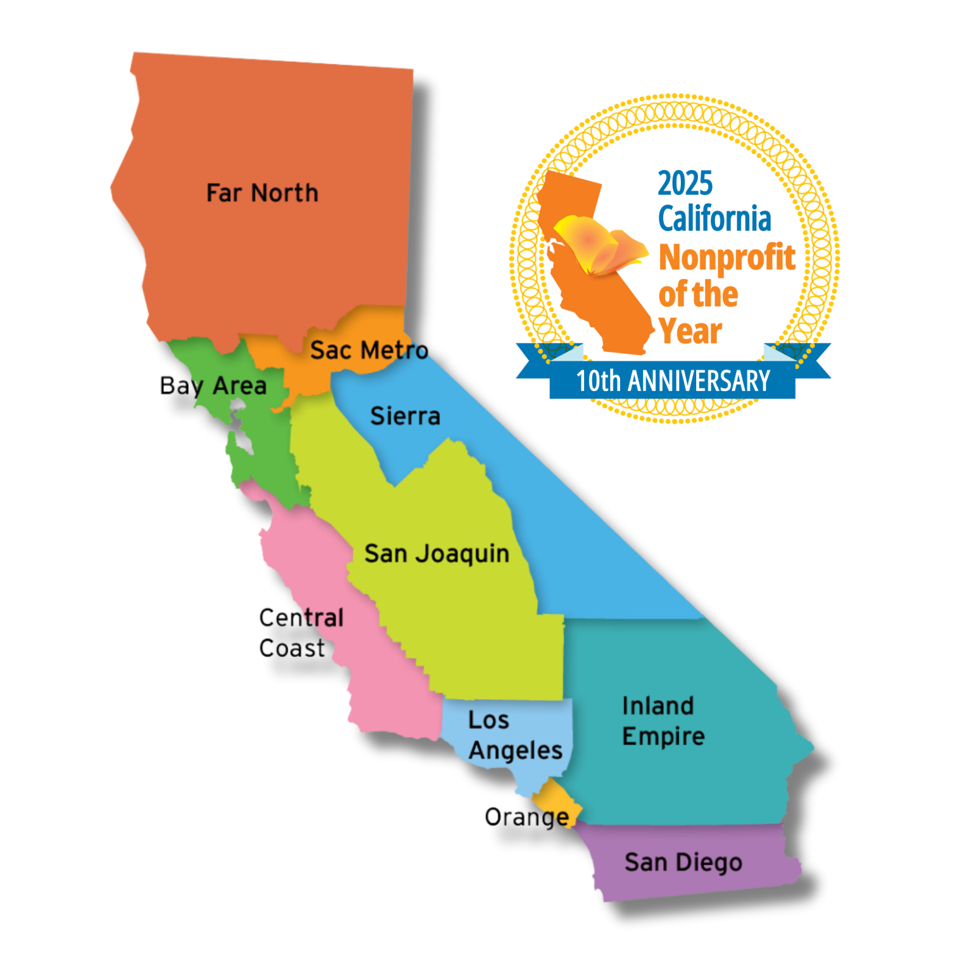
California Nonprofits Day
10th Annual Celebration held May 21st, 2025
1,009 nonprofits recognized since 2016!
Each state legislator honors a nonprofit from their district
118 (out of 119) members of the Senate and Assembly participated!
www.calnonprofits.org

Slide 39
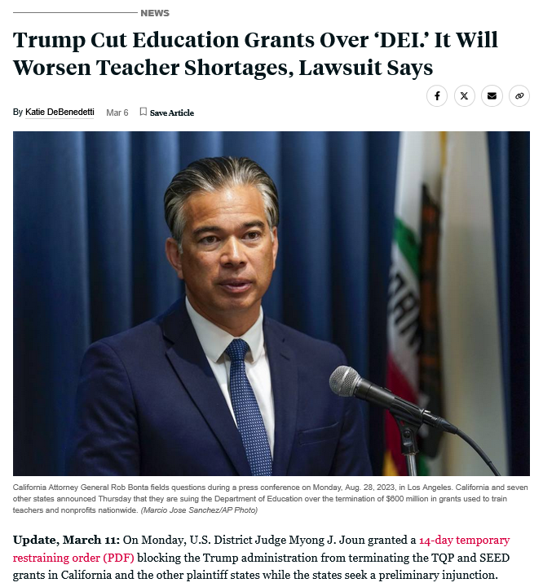
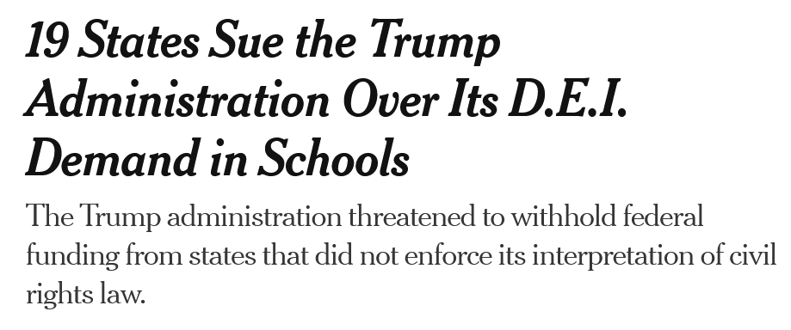
State Level Protections
www.calnonprofits.org

Slide 40
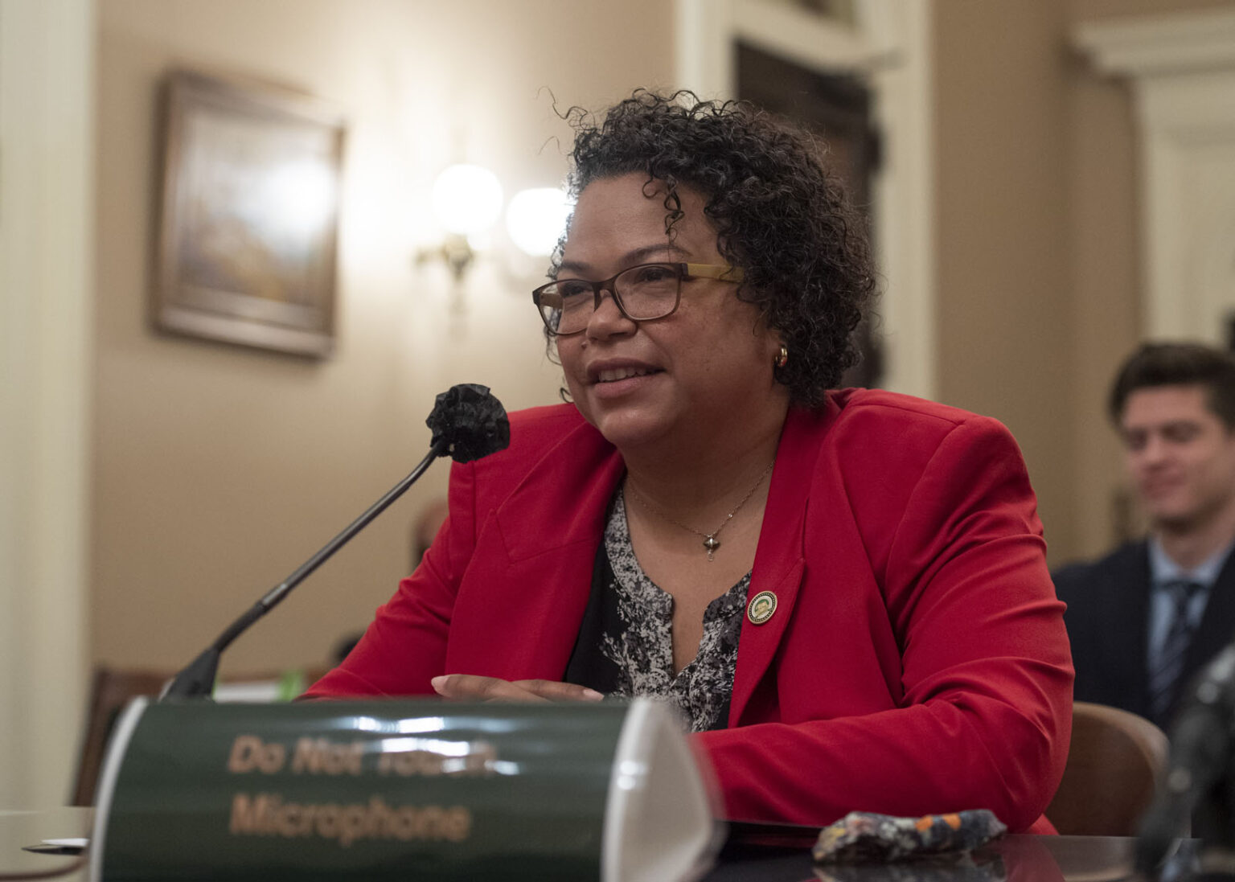
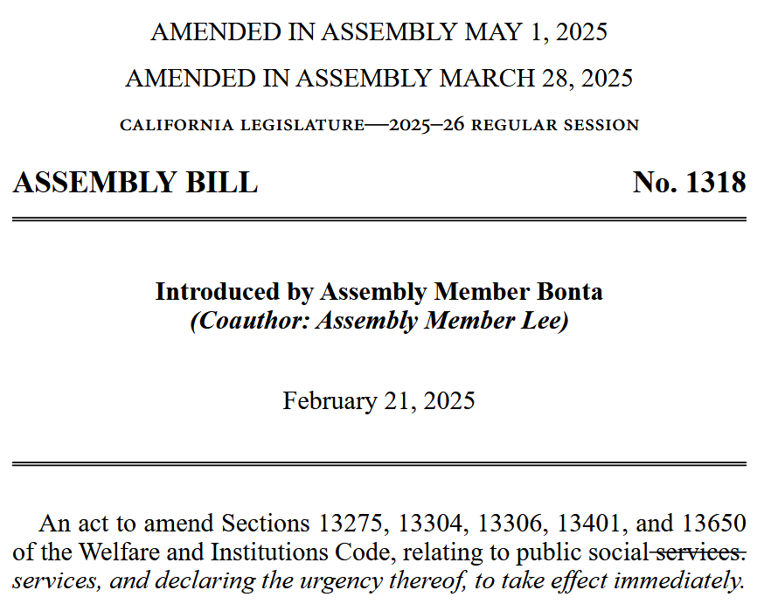
State Level Protections
www.calnonprofits.org

Slide 41

CA Nonprofit Equity Initiative - 2025
AB 1039 – Hart
  Builds on the state’s existing advance payment practices for state grants and contracts by requiring all new opportunities to offer advance payment beginning January 1, 2026. Status: Two Year Bill
AB 880 – Bennett (Limón and Umberg)
  Require timely payments and simplify indirect cost coverage to level the playing field for all nonprofits. Status: Two Year Bill
AB 265 – Caloza
  Grant funding to aid fire recovery and rebuilding; creates the Small Business Recovery Fund Act and nonprofits would be eligible to apply for these competitive grants. Status: Passed with amendments in the Assembly; now in Senate
2024 Outcomes:
SB 336 and SB 1246: unanimously approved by the legislature; both vetoed by Gov. Newsom
AB 2322: Held in suspense file; would’ve reduced application + reporting requirements for grants of $20,000 or less.

Slide 42
Other 2025 Policy Agenda Items
Past Successes:
SB 324 – Menjivar (Co-sponsor)
  Strengthens participation of community-based organizations (CBOs) as essential Medi-Cal providers through adequate funding and red tape reductions
AB 339 – Ortega (Oppose)
  New noticing requirements for public agencies before they issue an RFP of 120 days; contracting barrier
Collaboration with the Attorney General’s Office to streamline charity registration processes
Responding to the emerging insurance crises
Federal advocacy: defending against threats to nonprofits
Advance payment for nonprofit contracting (AB 590)
Online fundraising platforms (AB 488)
State grants portal
(AB 2522)
Creation of Select Committees on the Nonprofit Sector

Slide 43
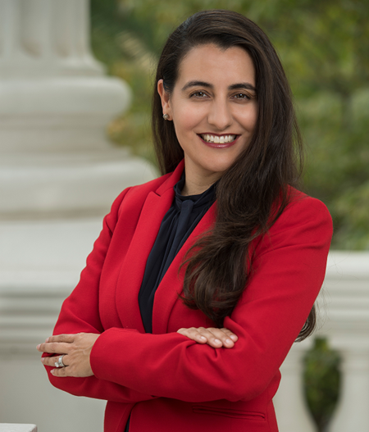

Select Committees on the Nonprofit Sector
2017: Assembly Select Committee on the Nonprofit Sector Established
2021: Senate Select Committee on the Nonprofit Sector Established
2022 Hearing: A Blueprint to Ensure Nonprofits are Supported and Thrive During Future Emergencies
2024 Hearing: Barriers and Solutions to Nonprofit Participation in State Government
Sen. Monique Limón
Chair, Senate Select Committee
Asm. Gregg Hart
Chair, Assembly Select Committee

Slide 44

Office of Nonprofit Empowerment
A Voice of, by, and for Nonprofits in State Government
Changing how state government works with the nonprofit sector
Institutionalize support for nonprofits to navigate government structures
Create a centralized point of contact in state government for policy research and development, interagency coordination, and training and education
CalNonprofits is proposing a state investment of $3.4 million over four fiscal years, matched 1:1 by philanthropy
www.calnonprofits.org

Slide 45
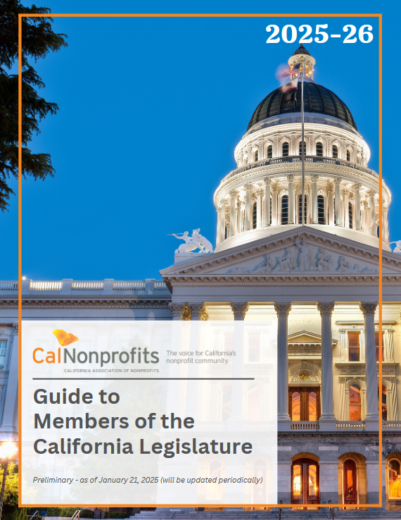
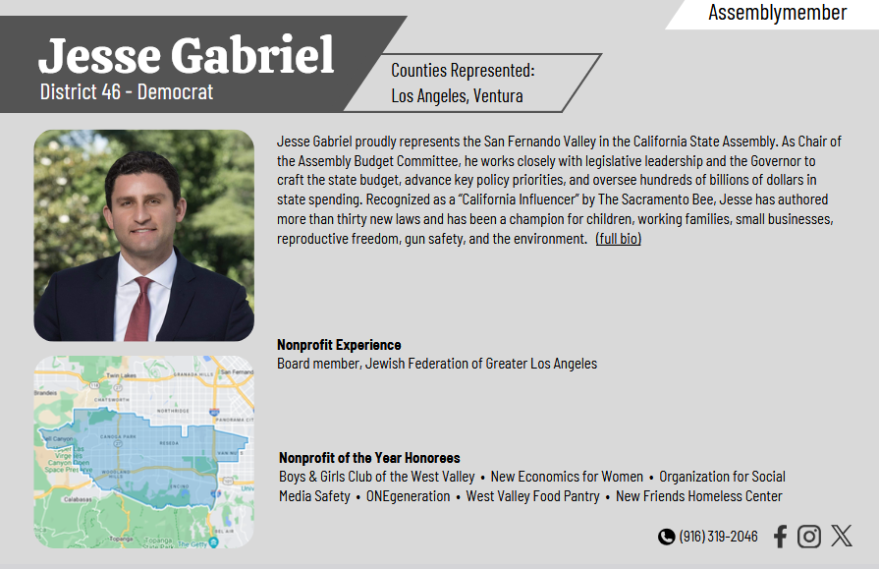
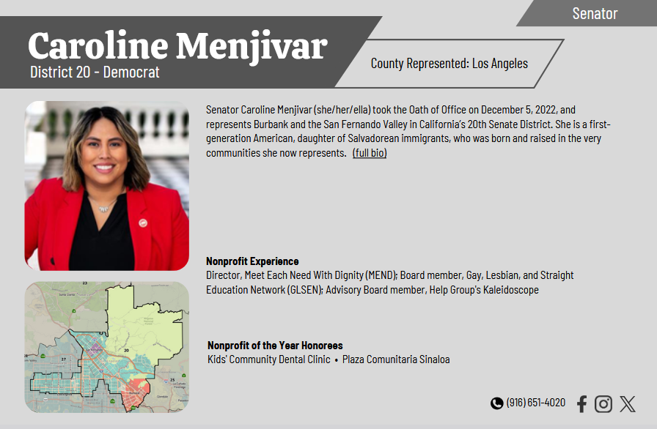
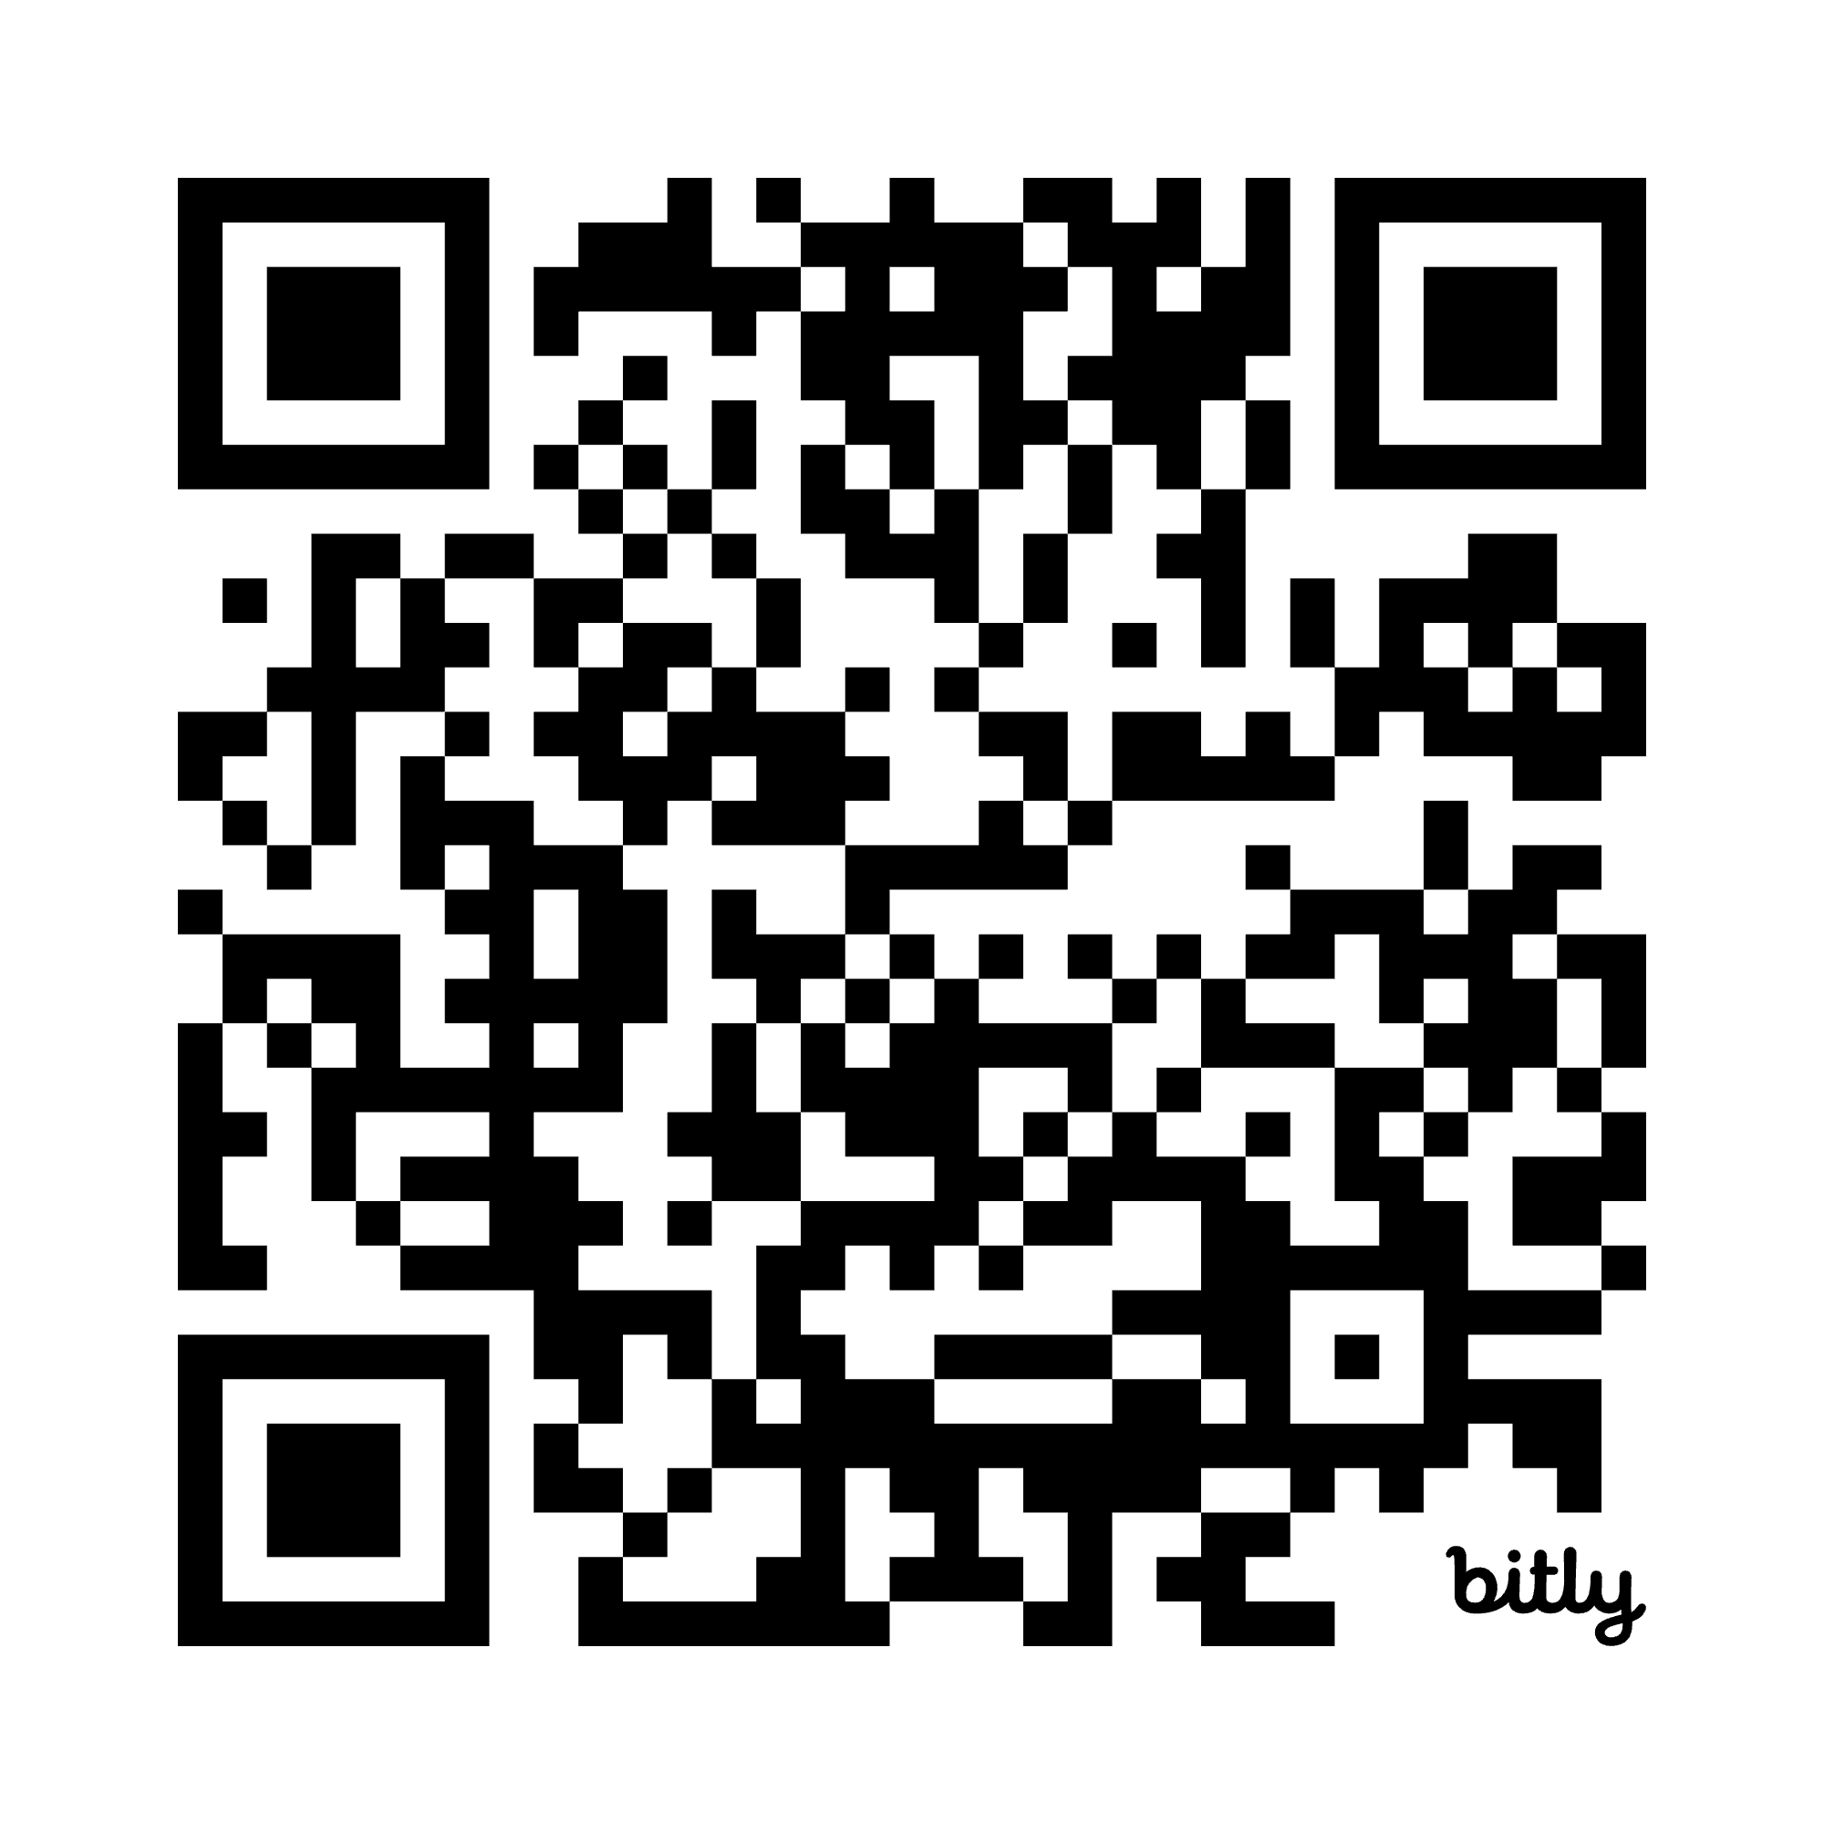
Introducing a New Tool for CA Nonprofits
www.calnonprofits.org

Slide 46

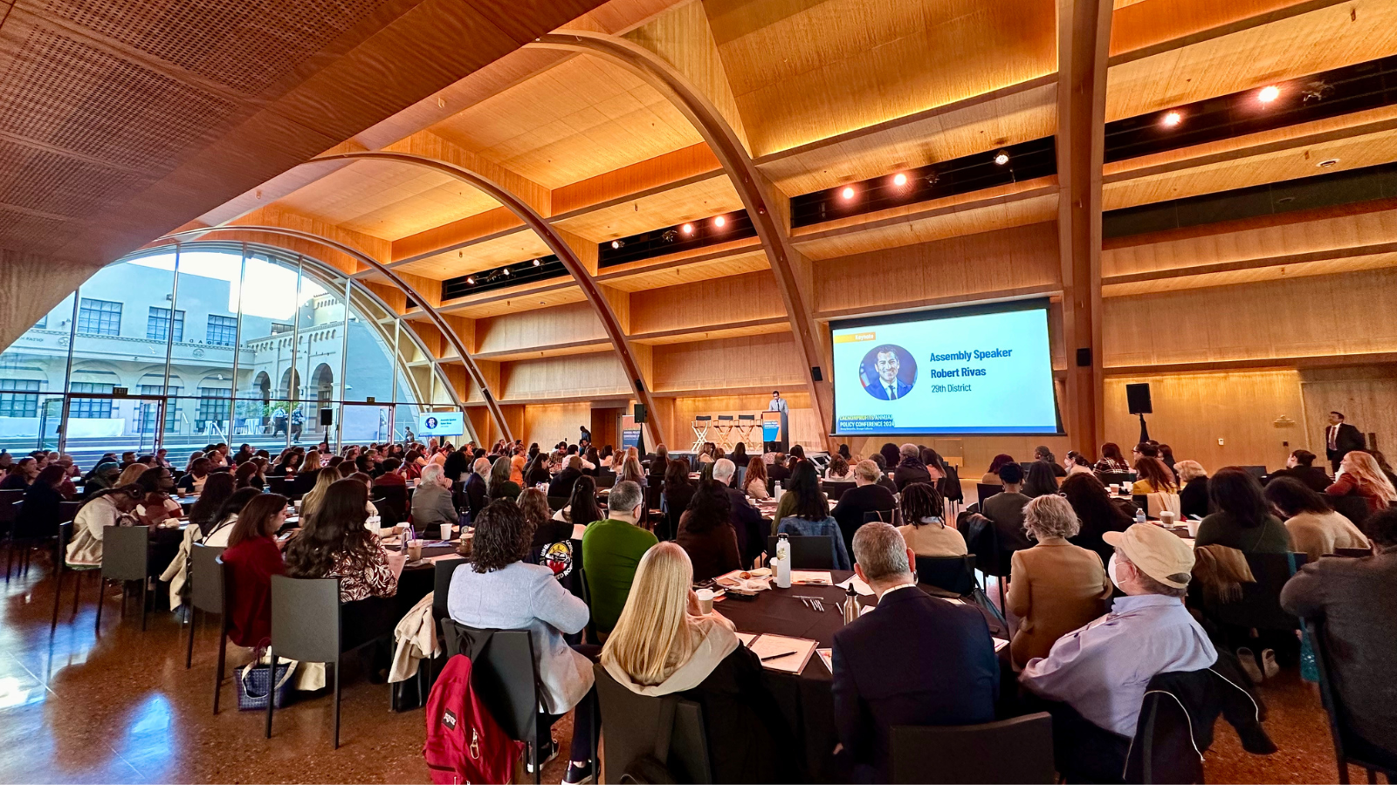

Annual Policy Conference: November 5th in LA
Early Registration Ends Today!

Slide 47
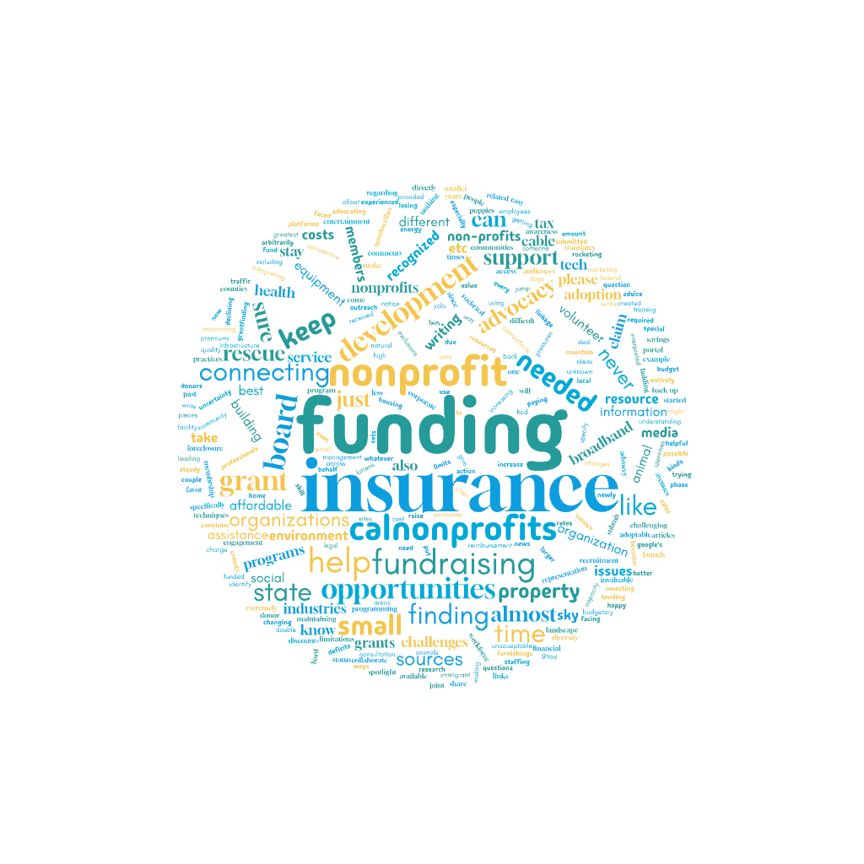


What Our Members Are Telling Us
www.calnonprofits.org

Slide 48
How would you describe your organization's current situation?

Slide 49
What are the challenges your organization is facing?

Slide 50
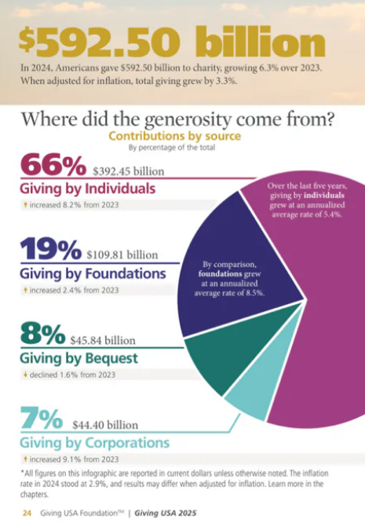
Other Trends…
Giving is growing, but not keeping up with inflation.
www.calnonprofits.org

Slide 51
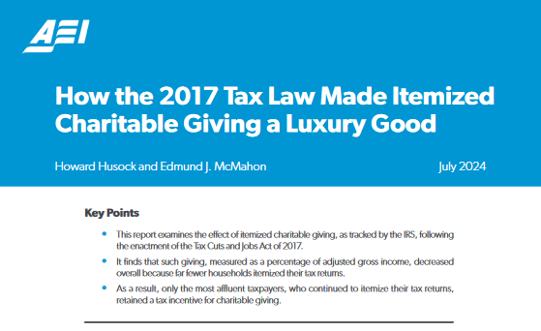
Other Trends…
2017 tax law dramatically reduced charitable giving
~ 23 million fewer itemizers = estimated $20 billion decline
www.calnonprofits.org

Slide 52
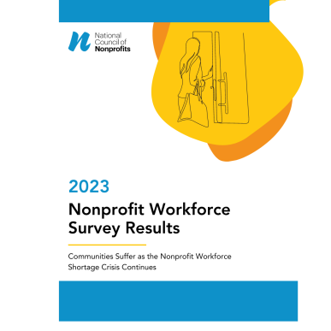
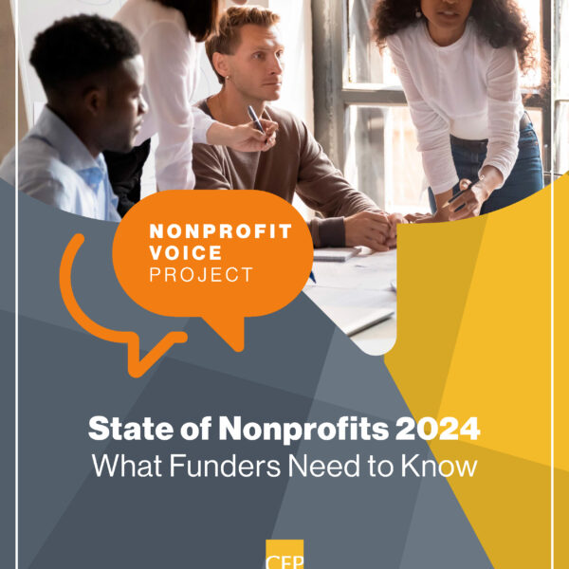
Other Trends…
Concerns about the nonprofit workforce: compensation, shortages, and burnout
www.calnonprofits.org

Slide 53
Advocate, Litigate, Communicate, and Coordinate
Executive orders and memos are not the final word – we must defend and make use of our system’s checks & balances
There are 334 active lawsuits to slow or stop the Administration’s attacks on civil society as of August 15, 2025.
Every action is an opportunity to unify in defense of the nonprofit sector’s values — the people & communities we serve.
Risk mitigation is important, but we must not overcorrect by pausing or stopping important, lawful work in the sector.
Those in a position of relative safety and power must push back and help those directly threatened and targeted
www.calnonprofits.org

Slide 54
Reach out anytime…
Web
Geoff Green,
Chief Executive Officer
Email: geoffg@calnonprofits.org
Mobile: 805-637-3760
Jeannette Brown,
Director of Public Policy
Email: jbrown@calnonprofits.org
Mobile: 714-600-1514
CalNonprofits
Website: www.calnonprofits.org
www.calnonprofits.org

Slide 55


Slide 56
NON
TOWNHALL
PROFIT
Thank you!

Slide 57



WE WANT TO HEAR FROM YOU
TAKE OUR
SURVEY

