Slide 1






NON
TOWNHALL
PROFIT
Friday, August 16, 2024
10 AM - 12 PM

Slide 2

Thank you to our host!

Slide 3
Thank you to our partners!

Slide 4
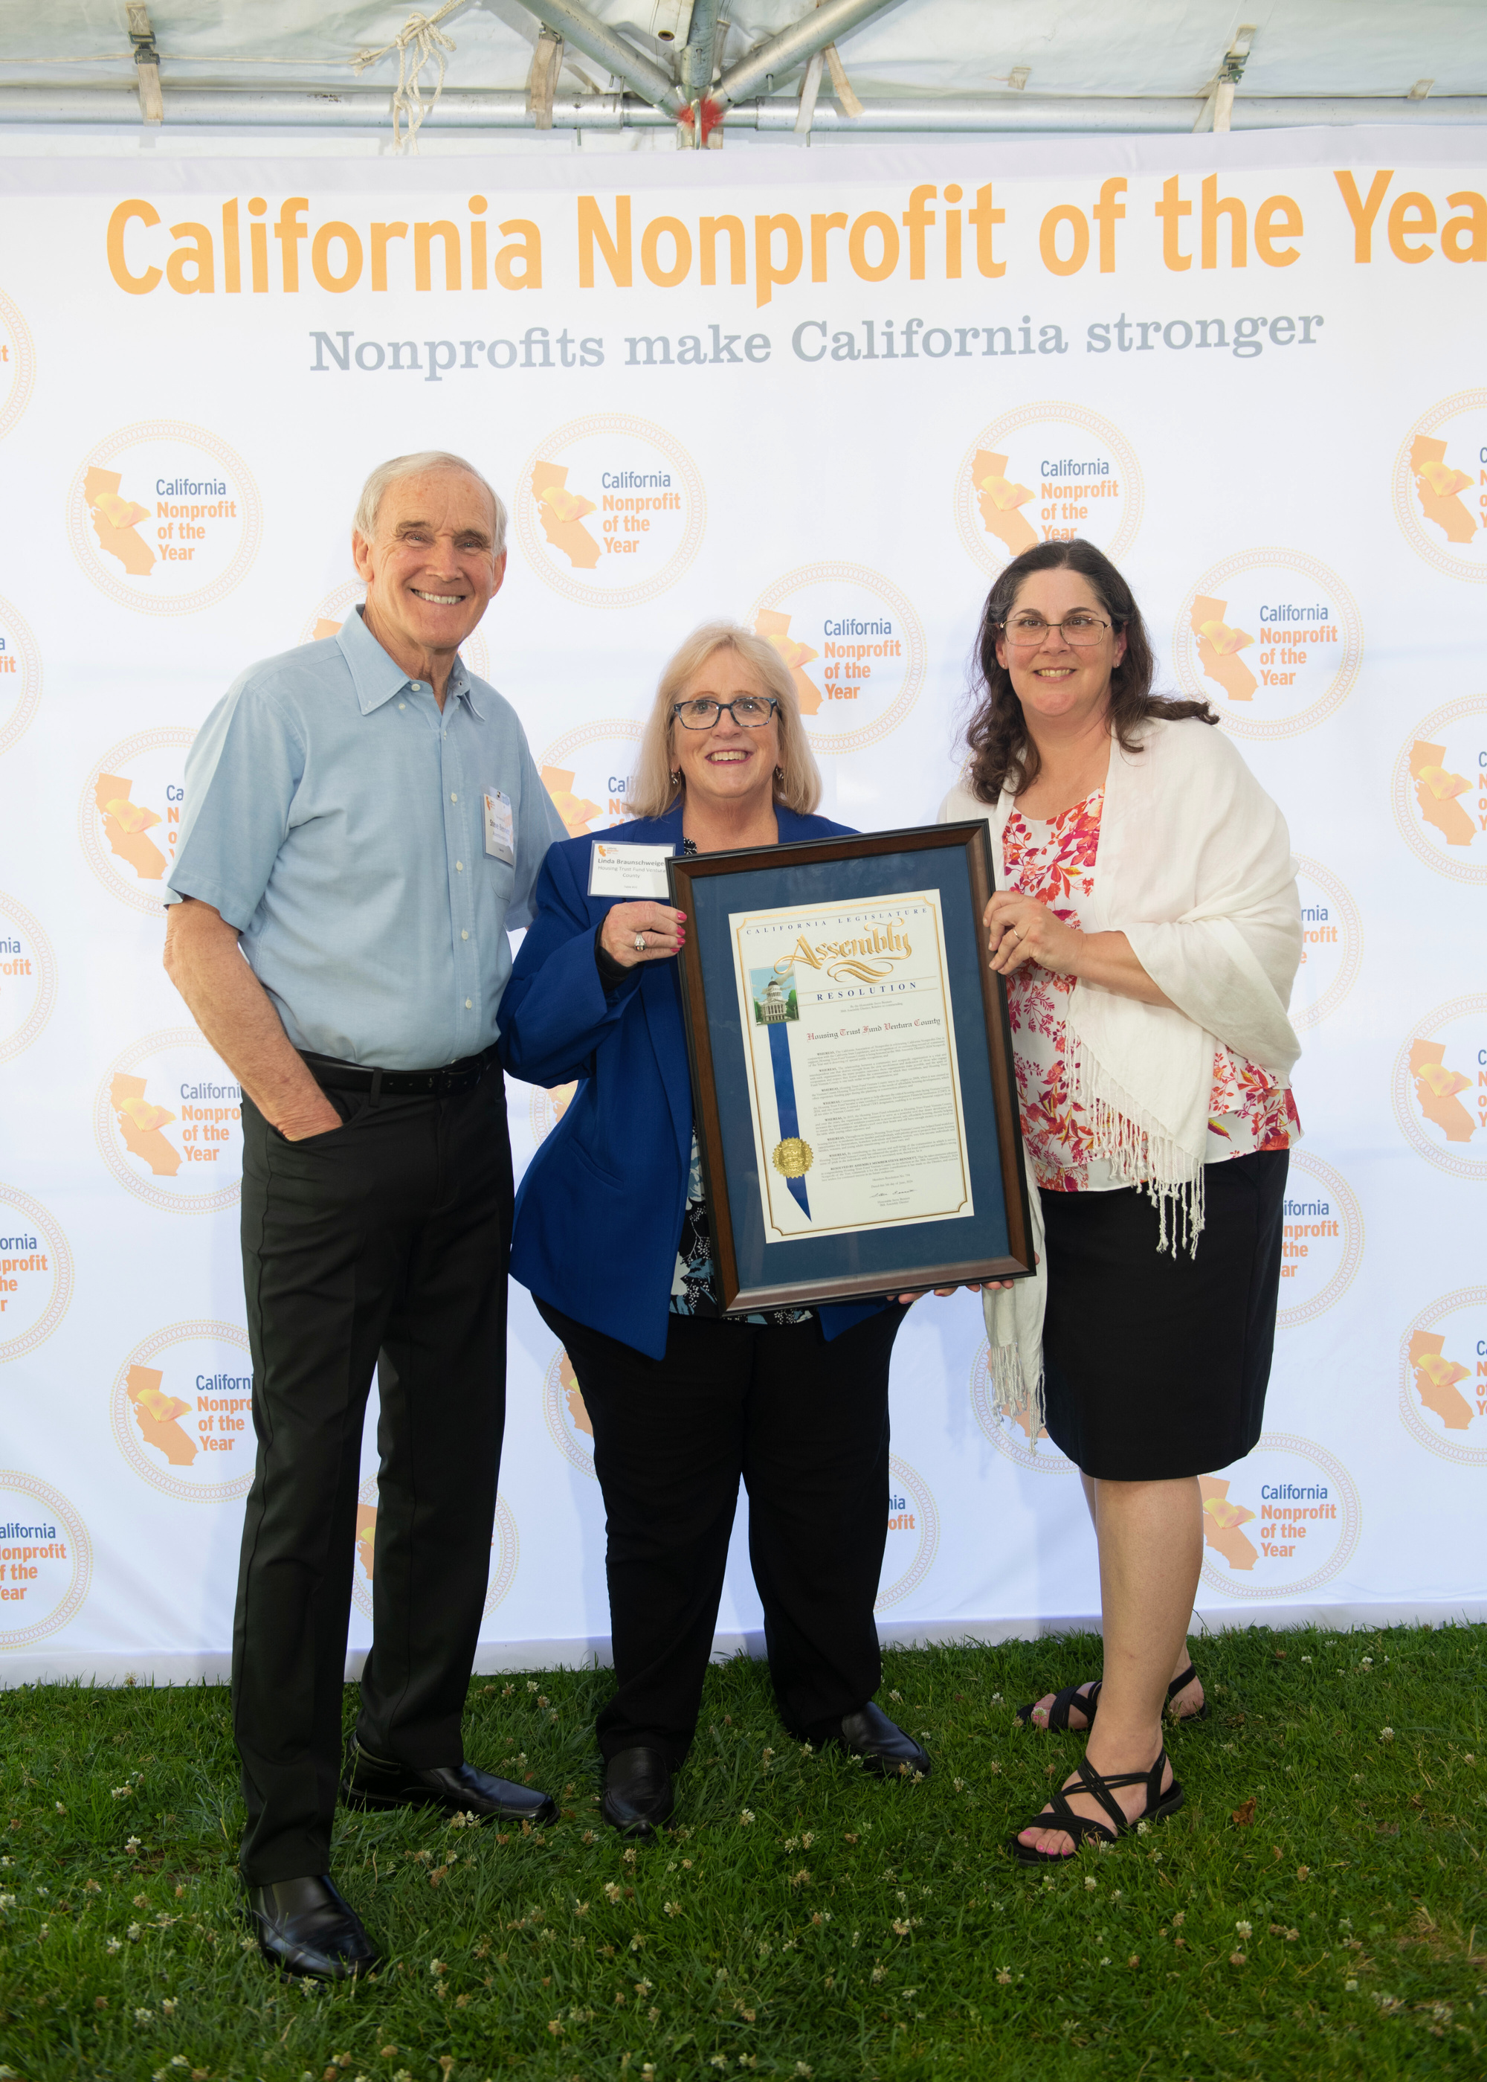
38th Assembly District's
2024 Nonprofit of the Year
Housing Trust Fund of Ventura County

Slide 5
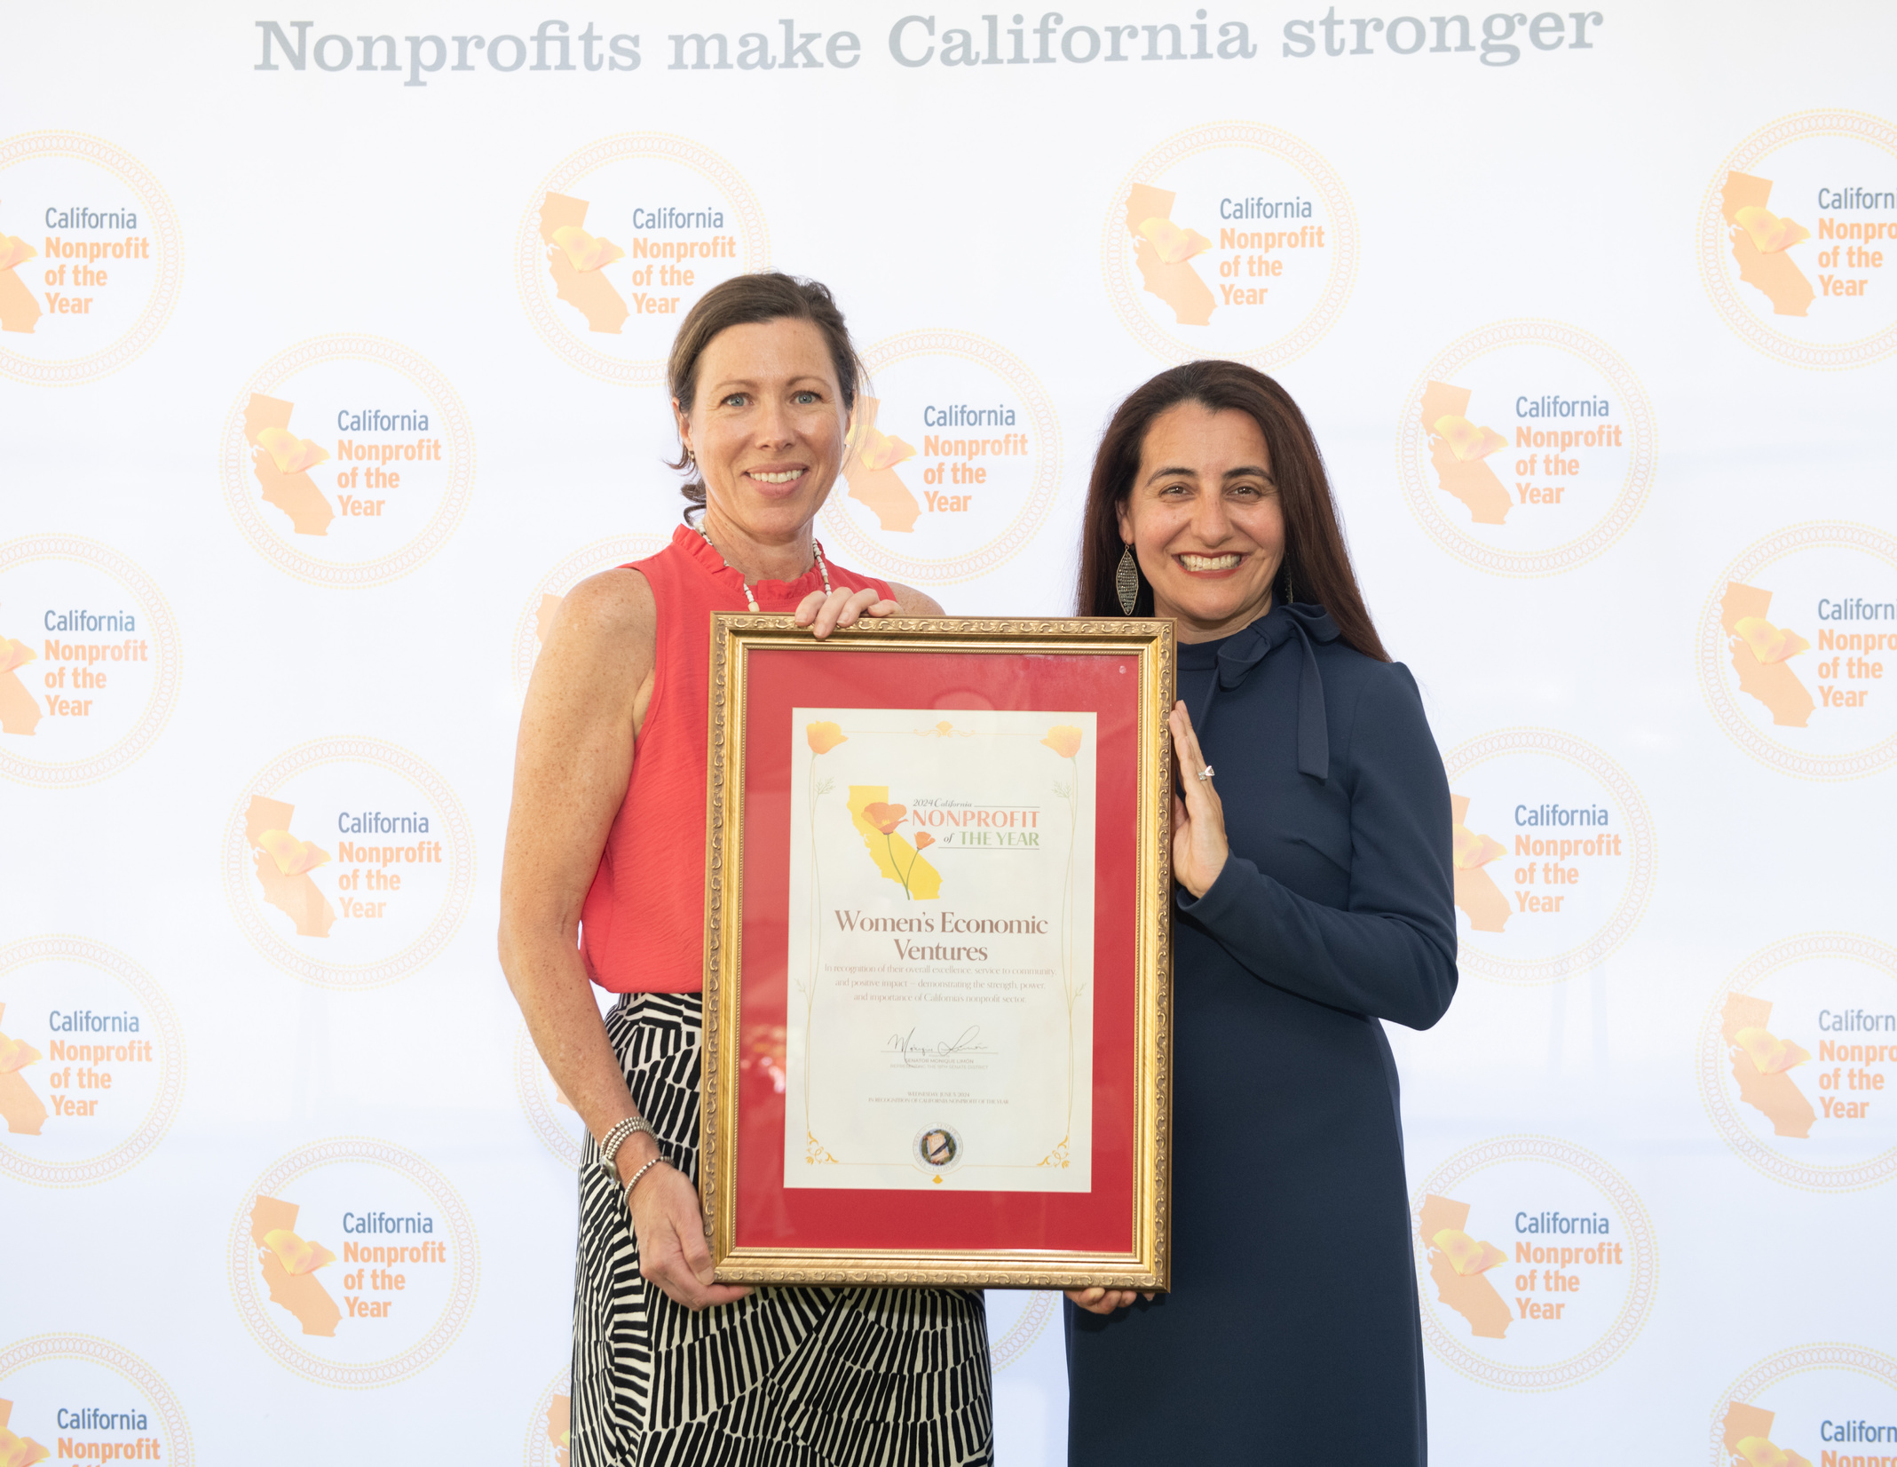
19th Senate District's
2024 Nonprofit of the Year
Women's Economic Ventures

Slide 6

Update from
Assemblymember Steve Bennett

Slide 7
AB 590 (Hart, 2023-24)
State-funded assistance grants and contracts: advance payments
  Signed by Governor, 2023
  Authorizes state agencies to provide nonprofits up to 25% of contracted funds up front
  Prioritizes nonprofits serving vulnerable communities or those with modest reserves

Slide 8
AB 1185 (Gabriel, 2023-24)
California State Nonprofit Security Grant Program.
  This bill expands eligibility for the California State Nonprofit Security Grant Program (CSNSGP)
  Signed by Governor, 2023
  Provides funding support for physical security enhancements to nonprofit organization that are at high risk of violent attacks and hate crimes due to their ideology, beliefs or mission.

Slide 9
AB 2322 (Hart & Bennett, 2023-24)
Grant programs: administration.
  This bill simplifies grant application process for seeking small awards of $20,000 or less.
  This bill requires that grants to be submitted online and reduces redundant reporting obligations
  AB 2322 obligates the State to reach out to eligible nonprofit organizations at least 90 days before the application deadline for grant programs of $20,000 or more.

Slide 10
SB 336 (Umberg, 2023-24)
State grant programs: negotiated indirect cost rates.
  This bill would ensure that nonprofits are fairly compensated by the state for the full cost of providing services funded by state grants by ensuring nonprofits are reimbursed for indirect costs.
  This bill will require the Department of General Services to establish a process by which nonprofits may negotiate a uniform state indirect cost agreement to cover reimbursement of indirect costs for state-funded grants.
  Requires the state to pay a nonprofit contractor its negotiated federal rate, and establishes a standard state rate for nonprofit partners of no less than 10%

Slide 11
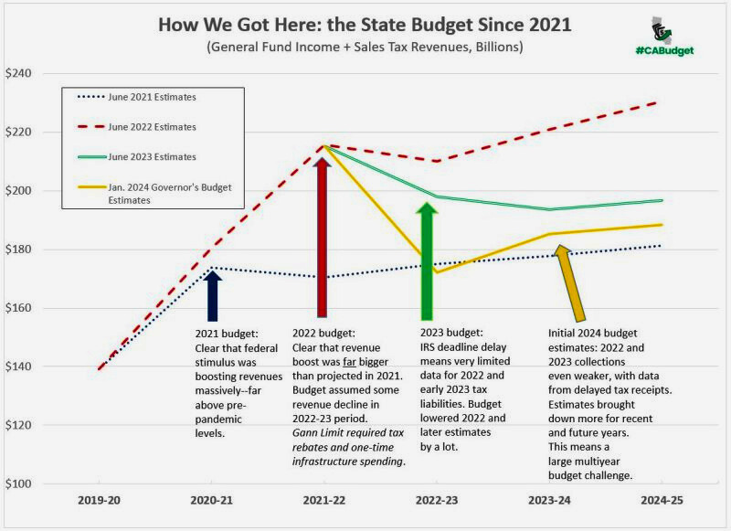
California State Budget (2024-25)
Budget agreement addressed a $46.8 billion deficit. Part of the budget agreement reached proposes additional legislation requiring the state to set aside a portion of anticipated surplus funds to be allocated in a subsequent Budget Act—adding further fiscal protection so the state does not commit certain amounts of future anticipated revenues until those revenues have been realized.

Slide 12
California State Budget (2024-25)
Budget solves a $46.8 billion deficit for the 2024-25 through a mix of broad-based solutions:
Reductions
Revenue / Internal Borrowing
Reserves
Fund Shifts
Delays & Pauses
Deferrals
$16 billion
$13.6 billion
$6 billion
$6 billion
$3.1 billion
$2.1 billion

Slide 13

Update from
Senator Monique Limón

Slide 14
SB 1246 (Limón, 2023-24)
California Prompt Payment Act: nonprofit organizations.
  This bill aims to enhance equity for these nonprofits by ensuring they receive state grants and contract payments promptly, thereby supporting their ongoing contributions to community betterment.

Slide 15
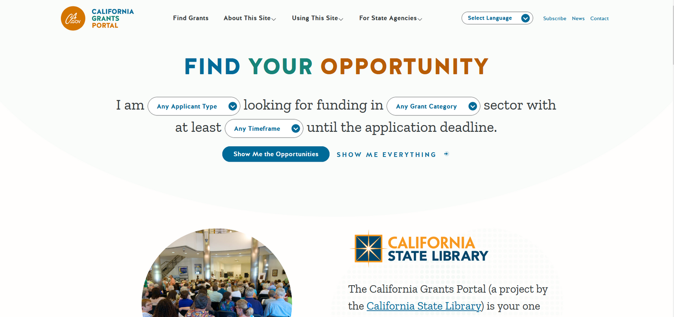
California Grants Portal

Slide 16
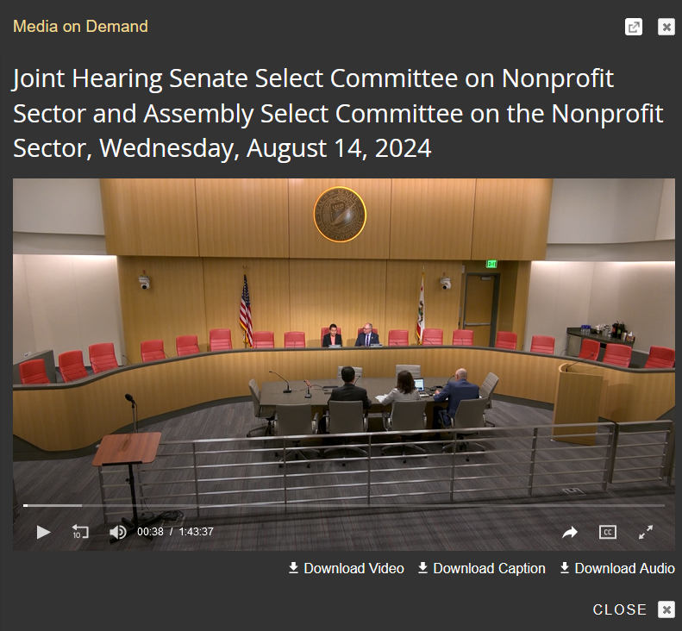
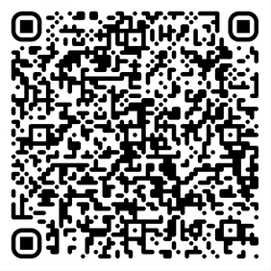
Joint Select Committee on Nonprofits
www.senate.ca.gov/media-archive
scan to view this hearing

Slide 17
Speaker Panel
Moderated by Dena Jenson
CLU Center for Nonprofit Leadership
Linda Braunshweiger
Kelly Brown
Geoff Green
Nicki Parr
Mike Silacci
Housing Trust Fund Ventura County
Interface Children & Family Services
CalNonprofits
Women's Economic Ventures
Ventura County Community Foundation

Slide 18
NON
TOWNHALL
PROFIT
Thank you!

